Slide 1
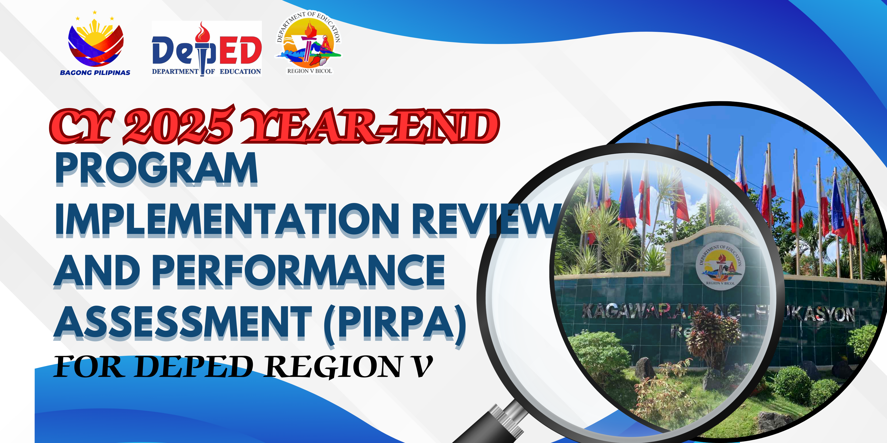

Slide 2


OFFICE: | SDO IRIGA CITY
HEAD: | MARIA-MAGNOLIA F. BRIOSO

Slide 3
SUMMARY OF THE PHYSICAL AND COMMITTED OUTPUTS AND TARGETS
Percentage of Assessment | NO. ACCOMPLISHED COMMITTED OUTPUTS
0-25% | 0
26-50% | 0
51-75% | 16
76-100% | 102

Slide 4
INTERMEDIATE OUTCOMES PERFORMANCE INDICATORS
(per DepEd Oder No. 29, s. 2022 – Agency Performance Measurement Matrix)

Slide 5
Program, project and activities
(continuing)

Slide 6
ACCESS
IO: All school-age children, out-of-school youth, and adults accessed relevant basic learning opportunities

Slide 7
PPA/Line Item | Physical |  |  |  | Reasons for over/underperformance
 | Performance Indicator | Physical Target (Annual) | Accomplishment (Q1+Q2+Q3+Q4)
 |  |  | Number | %
Basic Education Facilities- Repair | No. of classroom repaired | 0 | 0 | 0
BEFF –SF (Acquisition of School Desks, Furniture and Fixtures | No. of furniture delivered | 0 | 0 | 0
BEFF-EAO-ELEC (Electrification) | No. of schools electrified/ upgraded | 0 | 0 | 0
BEFF-PSHF (Priority School Health Facilities) | No. of Health Facilities constructed | 0 | 0 | 0
BEFF-EAO (Engineering and Administrative Overhead) | No. of Monitoring/Visit conducted | 0 | 0 | 0

Slide 8
PPA/Line Item | Physical |  |  |  | Reasons for over/underperformance
 | Performance Indicator | Physical Target (Annual) | Accomplishment (Q1+Q2+Q3+Q4)
 |  |  | Number | %
QRF (Quick Response Fund) | No. of classrooms constructed | 0 | 0 | 0
 | No. of Classrooms repaired | 0 | 0 | 0
 | No. of slope protection constructed | 0 | 0 | 0

Slide 9
PPA/Line Item | Physical |  |  |  | Reasons for over/underperformance
 | Performance Indicator | Physical Target (Annual) | Accomplishment (Q1+Q2+Q3+Q4)
 |  |  | Number | %
GABALDON (Conservation and restoration of Gabaldon and other heritage school buildings) | No. of Gabaldon repaired/ conserved | 0 | 0 | 0
IASS (Improvement and Acquisition of School Sites) | No. of schools provided for support fund for School Site survey, Transfer and Titling and Registration of Special Patents provided | 0 | 0 | 0
LMSP (Last Mile Schools Program) | Number of Last Mile School classrooms constructed and repaired | 0 | 0 | 0
 | Number of Monitoring/visits conducted | 0 | 0 | 0

Slide 10
PPA/Line Item | Physical |  |  |  | Reasons for over/underperformance
 | Performance Indicator | Physical Target (Annual) | Accomplishment (Q1+Q2+Q3+Q4)
 |  |  | Number | %
NSPP(New School Personnel Positions) | Number of new teaching positions filled-up | 0 | 0 | 0
SBFP (School-Based Feeding Program) | No. of recipient's schools | 40 | 40 | 100%
 | No. of recipient learners | 2066 | 2066 | 100%

Slide 11
EQUITY
IO: Disadvantaged school-age children and youth, and adults benefited from appropriate equity initiatives

Slide 12
PPA/Line Item | Physical |  |  |  | Reasons for over/underperformance
 | Performance Indicator | Physical Target (Annual) | Accomplishment (Q1+Q2+Q3+Q4)
 |  |  | Number | %
SPED (Special Education Program-SNED) | No. of Schools Offering the program | 41 | 41 | 100%
 | No. of Enrolment | 356 | 356 | 100%
 | No. of Activities Conducted | 2 | 1 | 50% | Unable to implement the program due to document completion.. Documents are already ready/accomplished and ready for implementation on the first quarter of calendar year 2026
IPEd (Indigenous Peoples Education Program) | No. of Schools Offering the program | 40 | 40 | 100%
 | No. of Enrolment | 1626 | 1626 | 100%
 | No. of Activities Conducted | 3 | 3 | 100%
 | No. of Schools with program support funds (PSF) received | 0 | 0 | 0

Slide 13
PPA/Line Item | Physical |  |  |  | Reasons for over/underperformance
 | Performance Indicator | Physical Target (Annual) | Accomplishment (Q1+Q2+Q3+Q4)
 |  |  | Number | %
MG (Multigrade Education Program) | No. of Schools Offering the program | 2 | 2 | 100%
 | No. of Enrolment | 123 | 123 | 100%
ALS (Alternative Learning System) | No. of Schools Offering the Program | 42 | 42 | 100%
 | No. of Enrolment | 1050 | 911 | 86%
 | No. of Activities Conducted | 2 | 2 | 100%
 | No. of ALS teachers with paid transportation and teaching aid allowance | 20 | 20 | 100%
 | No. of CAIs teachers with paid transportation and teaching aid allowance | 0 | 0 | 0
MEP (Madrasah Education Program) | No. of Schools Offering the Program | 1 | 1 | 100%
 | No. of Enrolment | 39 | 39 | 100%
 | No. of Asatidz paid | 2 | 2 | 100%
 | No. of Activities Conducted | 0 | 0 | 0

Slide 14
Quality
IO: Learners complete K-12 basic education, having successfully attained all learning standards that equip them with the necessary skills and attributes to pursue their chosen paths

Slide 15
PPA/Line Item | Physical |  |  |  | Reasons for over/underperformance
 | Performance Indicator | Physical Target (Annual) | Accomplishment (Q1+Q2+Q3+Q4)
 |  |  | Number | %
DepEd Computerization Program (DCP) | No. of ICT packages delivered | 0 | 0 | 0
 | No. of activities conducted | 0 | 0 | 0
 | No. of schools monitored | 0 | 0 | 0
Learning Tools Equipment (LTE) – Science and Mathematics (SM) | No. of tools and equipment delivered | 0 | 0 | 0
 | No. of learners benefiting the program | 0 | 0 | 0

Slide 16
PPA/Line Item | Physical |  |  |  | Reasons for over/underperformance
 | Performance Indicator | Physical Target (Annual) | Accomplishment (Q1+Q2+Q3+Q4)
 |  |  | Number | %
Learning Tools Equipment (LTE) – Tech-Voc and Livelihood(TVL) Equipment | No. of tools and equipment delivered | 74 | 74 | 100%
 | No. of learners benefiting the program | 19 | 19 | 100%
ELLN (Early Language Literacy and Numeracy) | No. of Activity Conducted | 0 | 0 | 0
 | No. of teachers trained | 0 | 0 | 0
MOOE Elementary (Kindergarten to Grade 6) | No. of public schools provided with MOOE | 0 | 0 | 0
MOOE JHS (Grade 7 to 10) | No. of public schools provided with school MOOE | 0 | 0 | 0

Slide 17
PPA/Line Item | Physical |  |  |  | Reasons for over/underperformance
 | Performance Indicator | Physical Target (Annual) | Accomplishment (Q1+Q2+Q3+Q4)
 |  |  | Number | %
MOOE SHS (Grade 11 to 12) | No. of public schools provided with school MOOE | 0 | 0 | 0
Textbooks (and Other Instructional materials) | No. of schools provided with textbooks/instructional materials | 0 | 0 | 0
NASBE (National Assessment Systems for Basic Education ) | No. of National Assessments conducted | 3 | 3 | 0
 | No. of Activities conducted | 0 | 0 | 0
FLO (Flexible Learning Options) | No. of Schools Provided with Learning Resources | 0 | 0 | 0

Slide 18
PPA/Line Item | Physical |  |  |  | Reasons for over/underperformance
 | Performance Indicator | Physical Target (Annual) | Accomplishment (Q1+Q2+Q3+Q4)
 |  |  | Number | %
ADM (Alternative Delivery Mode) | No. of Activities Conducted | 0 | 0 | 0
ALSADM (Implementation of Alternative Learning and Delivery Mode Programs, including requirement of Learning Centers) | No. of Activities Conducted | 0 | 0 | 0
 | No. of materials procured | 0 | 0 | 0
 | No. of training/seminars/conferences attended | 0 | 0 | 0
Journalism | No. of students participated in the National Press Conference | 0 | 0 | 0
 | No. of Activities Conducted | 0 | 0 | 0

Slide 19
PPA/Line Item | Physical |  |  |  | Reasons for over/underperformance
 | Performance Indicator | Physical Target (Annual) | Accomplishment (Q1+Q2+Q3+Q4)
 |  |  | Number | %
HRTD (Human resource development for Personnel in Schools, and Learning Centers) | No. of teachers trained | 1129 | 1129 | 100%
 | No. of teaching-related employees trained | 86 | 86 | 100%
 | No. of trainings conducted | 9 | 9 | 100%
 | No. of Activities conducted | 1 | 1 | 100%

Slide 20
resiliencY and well-being
IO: Learners are resilient and know their rights and have the life skills to protect themselves and claim their education-related rights from DepEd and other duty-bearers to promote learners’ well-being.

Slide 21
PPA/Line Item | Physical |  |  |  | Reasons for over/underperformance
 | Performance Indicator | Physical Target (Annual) | Accomplishment (Q1+Q2+Q3+Q4)
 |  |  | Number | %
Administrative Personnel Benefit | No. of Employees paid
*Loyalty Pay |  | 0 | 0 | 0
*Terminal Leave |  | 0 | 0 | 0
*Monetization |  | 0 | 0 | 0
*Clothing Allowance |  | 0 | 0 | 0
*Cash Allowance |  | 0 | 0 | 0

Slide 22
PPA/Line Item | Physical |  |  |  | Reasons for over/underperformance
 | Performance Indicator | Physical Target (Annual) | Accomplishment (Q1+Q2+Q3+Q4)
 |  |  | Number | %
ERF (Implementation of the Grant of Cash Allowance, Hardship Pay, Equivalent Records Forms (ERF), Conversion to Master Teacher (MT), Reclassification of Positions and Payment of step increments (ERF) | No. of teachers paid of Hardship Pay | 0 | 0 | 0
 | No. of teachers paid of salaries | 0 | 0 | 0
 | No. of teachers paid of cash allowance | 0 | 0 | 0

Slide 23
PPA/Line Item | Physical |  |  |  | Reasons for over/underperformance
 | Performance Indicator | Physical Target (Annual) | Accomplishment (Q1+Q2+Q3+Q4)
 |  |  | Number | %
BEC (Basic Education Curriculum) | No. of learners participated in the activity (NLC) | 0 | 0 | 0
 | No. of Schools participated | 0 | 0 | 0
 | No. of teachers paid for their meal allowances | 0 | 0 | 0
 | No. of capacity building/orientation conducted | 0 | 0 | 0
 | No. of learning materials procured/produced | 0 | 0 | 0

Slide 24
PPA/Line Item | Physical |  |  |  | Reasons for over/underperformance
 | Performance Indicator | Physical Target (Annual) | Accomplishment (Q1+Q2+Q3+Q4)
 |  |  | Number | %
GMS (General Management Supervision | No. of activities conducted | 0 | 0 | 0
 | No. of personnel trained | 0 | 0 | 0
 | No. of training attended | 0 | 0 | 0
 | No. of Employee (COS, JO) hired | 0 | 0 | 0
 | No. of Employees paid for Salaries, Allowances, Benefits | 0 | 0 | 0
 | No. of bills (electricity, water, internet, communication…) paid | 0 | 0 | 0

Slide 25
PPA/Line Item | Physical |  |  |  | Reasons for over/underperformance
 | Performance Indicator | Physical Target (Annual) | Accomplishment (Q1+Q2+Q3+Q4)
 |  |  | Number | %
MOOE Elementary (K to Grade 6) | No. of schools provided with MOOE | 0 | 0 | 0
MOOE JHS (Grade 7 to 10) | No. of Schools provided with MOOE | 0 | 0 | 0
MOOE SHS (Grade 11-12) | No. of Schools Provided with MOOE | 0 | 0 | 0
World Teacher’s Day Incentive | No. of teachers/employee paid | 0 | 0 | 0
OPDNTP (Organizational and Professional Development for Non-Teaching Personnel ) | No. of Non-Teaching Personnel Trained | 98 | 66 | 70.41% | Training Workshop on Financial Enhancement Management was rescheduled in Feb. 2026
 | No. of Training Conducted | 2 | 1 | 50%
 | No. of Other Activities Conducted | 3 | 3 | 100%

Slide 26
PPA/Line Item | Physical |  |  |  | Reasons for over/underperformance
 | Performance Indicator | Physical Target (Annual) | Accomplishment (Q1+Q2+Q3+Q4)
 |  |  | Number | %
LSP (Learner’s Support Fund) | No. of Schools with program support fund downloads | 0 | 0 | 0
 | No. of Activities conducted | 0 | 0 | 0
 | No. of Procurement Made | 0 | 0 | 0
BPLP (Building Partnerships and Linkages Program) | Number of partners with MOA | 0 | 0 | 0
 | Number of Volunteers | 0 | 0 | 0
 | Number of Activities Conducted | 0 | 0 | 0
CPP (Child Protection Program | No. of Activities Conducted | 0 | 0 | 0

Slide 27
PPA/Line Item | Physical |  |  |  | Reasons for over/underperformance
 | Performance Indicator | Physical Target (Annual) | Accomplishment (Q1+Q2+Q3+Q4)
 |  |  | Number | %
HRTD (Human resource development for Personnel in Schools, and Learning Centers) | No. of personnel trained | 0 | 0 | 0
 | No. of trainings conducted | 10 | 10 | 100%
 | No. of Activities conducted | 0 | 0 | 0
NASBE (National Assessment Systems for Basic Education ) | No. of National Assessments conducted | 3 | 1 | 33.33% | Only Grade 6 NAT was Conducted
 | No. of Activities conducted | 0 | 0 | 0
DRRM (Disaster Preparedness Program) | No. of personnel/learners provided with emergency supplies | 0 | 0 | 0

Slide 28
PPA/Line Item | Physical |  |  |  | Reasons for over/underperformance
 | Performance Indicator | Physical Target (Annual) | Accomplishment (Q1+Q2+Q3+Q4)
 |  |  | Number | %
DPRP (Disaster Preparedness and Response Program) | No. of training conducted | 0 | 0 | 0
 | No. of personnel trained | 0 | 0 | 0
 | No. of Procured of Safety and Emergency Supplies and Equipment | 0 | 0 | 0
 | No. of Psychosocial Support Services to learners and staff conducted | 0 | 0 | 0
PALARO (Physical fitness and school sports competitions, including Palarong Pambansa | No. of procured sports supplies, materials and equipment | 0 | 0 | 0
 | No. of training conducted | 0 | 0 | 0
 | No. of activities conducted | 0 | 0 | 0

Slide 29
PPA/Line Item | Physical |  |  |  | Reasons for over/underperformance
 | Performance Indicator | Physical Target (Annual) | Accomplishment (Q1+Q2+Q3+Q4)
 |  |  | Number | %
PFSS (Physical Fitness and School Sports) | No. of schools provided with program support funds | 0 | 0 | 0
 | No. of activities conducted | 0 | 0 | 0
 | No. of Programs implemented related to sports development | 0 | 0 | 0

Slide 30
KEY PERFORMANCE INDICATORS AND Program, project and activities
(Current)

Slide 31
ACCESS
IO: All school-age children, out-of-school youth, and adults accessed relevant basic learning opportunities

Slide 32
Gross and Net Enrolment Rates
For Kindergarten, both GER and NER remained relatively stable over the three school years. GER declined steadily from 101.80% in SY 2022-2023 to 91.82% in SY 2024-2025, while NER hovered around 84.36%, with only minor fluctuations. This indicates a consistent enrolment of age-appropriate learners, but a decreasing trend in total enrolment, possibly due to fewer over-aged or under-aged children entering Kindergarten. In Elementary, both GER and NER peaked in SY 2022-2023 at 104.37% and 99.23%, respectively, before gradually declining in the following years.
By SY 2024-2025, GER had decreased to 101.59%, and NER fell to 94.50%, pointing to a slow but steady drop in enrolment, particularly among age-appropriate students. JHS showed a noticeable decline in GER, from 110.57% in SY 2022-2023 to 100.39% in SY 2024-2025, with NER also decreasing from 100.32% to 95.20% over the same period. This suggests a reduction in both overall and age-appropriate enrolment, possibly due to transition challenges or early dropouts. For SHS, GER significantly dropped from 137.16% in SY 2022-2023 to 113.34% in SY 2024-2025, while NER declined more gradually, from 92.46% to 89.57%. This sharp decrease in GER implies a reduction in over-aged enrollees, while the slight dip in NER signals potential issues in keeping students on track at this level.

Slide 33
Net Intake Rate
For Kindergarten, the Net Intake Rate remained quite stable over the three school years, starting at 84.04% in SY 2022-2023, slightly dipping to 83.94% in SY 2023-2024, and then rising marginally to 84.32% in SY 2024-2025. This indicates consistent enrolment of age-appropriate children entering Kindergarten each year.
In contrast, Grade 1 experienced a steady decline in Net Intake Rate across the same period. From 82.97% in SY 2022-2023, it dropped to 80.35% in SY 2023-2024, and then fell further to 76.13% in SY 2024-2025. This downward trend suggests that fewer age-appropriate learners are enrolling or transitioning into Grade 1, which could point to issues such as delays in school entry, dropouts after Kindergarten, or other barriers to progression.

Slide 34
Cohort Survival, Completion, and School Leaver Rates (CSR, CR & SLR)
In Elementary, both the CSR and CR remained consistently high at 99.64% in SY 2022-2023 and maintained stability at around 99% in SY 2024-2025, despite a slight dip to around 96% in SY 2023-2024. This indicates strong retention and completion in the elementary level with minimal fluctuations. For Junior High School, CSR and CR registered a slight decline in SY 2023-2024 (89.95% and 87.85%), followed by recovery to above 94.42% in SY 2024-2025. This shows improvement efforts may have been effective, yet consistency remains a concern in mid-grade retention. The transition from JHS to SHS likewise reflected a temporary drop in SY 2023-2024 (CSR 82.97% and CR 80.82%) but rebounded to 87.93% CSR and 85.31% CR in SY 2024-2025. Although
the rates improved, the figures suggest that a significant number of learners still face barriers when moving to senior high school.
Regarding the SLR, the data show a sharp increase in SY 2023-2024, especially in SHS, surging to 3.44%, before decreasing to 2.58% in SY 2024-2025. Despite the decline, the rates remain elevated compared to earlier years, highlighting persistent dropout challenges that require strategic interventions, particularly in secondary levels.

Slide 35
Transition and Retention Rates
The Transition Rate indicates a consistently strong upward trend in Senior High School (SHS), reaching its highest point at 116.53% in SY 2022–2023, followed by a slight dip but still maintaining high performance at 112.95% in SY 2024–2025. Junior High School (JHS) remained stable across the three school years, maintaining transition rates around 104%, reflecting steady learner movement to the next level. Elementary levels showed minor fluctuations, with a slight decline to 98.52% in SY 2023–2024, before rebounding to 99.63% in SY 2024–2025, suggesting generally consistent progression with minimal setbacks.
In terms of Retention Rate, a gradual decline is observed across all levels from SY 2022–2023 to SY 2023–2024. SHS recorded the highest retention at 101.69% in SY 2022–2023, but decreased to 98.27% in SY 2023–2024. Similarly, JHS dropped from 101.15% to 99.08%, and Elementary decreased from 98.33% to 96.50% over the same period. Although slight improvements are seen in SY 2024–2025, the rates have not fully returned to their previous highs.

Slide 36
ALS ENROLLMENT AND COMPLETION RATE
(3-year Comparative data)
The three-year data shows varied performance across learning levels. BLP enrollment increased to 51 in SY 2024–2025 after two years of low participation and notably produced its first 11 completers with a 22% completion rate, indicating initial gains but still highlighting the need to strengthen foundational literacy interventions.
Elementary enrollment remained relatively stable, but completion rates fluctuated between 23% and 30%, suggesting persistent challenges in learner retention and mastery of competencies.
JHS, which has the largest enrollment, showed stable participation but a slightly declining completion rate from 36% to 34%, implying that while access is sustained, completion remains a continuing concern.
In contrast, SHS consistently posted very high completion rates (99–100%), though a decline to 85% in SY 2024–2025
indicates that the rapid increase in enrollees also brought new completion challenges.
Overall, the data suggests that while access to ALS programs is expanding, especially in BLP and SHS, there is a critical
need to intensify learner support systems, strengthen early-level interventions, and implement closer monitoring and
targeted remediation strategies, particularly in BLP, Elementary, and JHS, to ensure improved retention and higher
completion outcomes across all levels.

Slide 37
ALS ENROLLMENT AND COMPLETION RATE
(3-year Comparative data)
The consolidated data for BLP, Elementary, JHS, and SHS shows that enrollment slightly declined from 881 in SY 2022–2023 to 748 in SY 2023–2024 but significantly increased to 911 in SY 2024–2025, indicating a strong recovery in learner participation. The number of completers also steadily increased from 349 to 374 across the three years, reflecting improved program implementation and learner support mechanisms. However, the completion rate, while improving to 45% in 2023–2024, slightly dropped to 41% in 2024–2025, suggesting that the rapid increase in enrollment also brought challenges in learner retention and completion.
This implies that while access to ALS programs is expanding, greater emphasis must now be placed on strengthening learner monitoring, academic support, and intervention programs to ensure that the increasing number of enrollees are not only participating but are also successfully completing the program.

Slide 38
PPA/Line Item | Physical |  |  |  | Reasons for over/underperformance
 | Performance Indicator | Physical Target (Annual) | Accomplishment (Q1+Q2+Q3+Q4)
 |  |  | Number | %
Basic Education Facilities- Repair | No. of classroom repaired | 76 | 0 | 0 | No Downloaded Funds from CO
BEFF –SF (Acquisition of School Desks, Furniture and Fixtures | No. of furniture delivered | 2,475 | 0 | 0 | No Downloaded Funds from CO
BEFF-EAO-ELEC (Electrification) | No. of schools electrified/ upgraded | 0 | 0 | 0
BEFF-PSHF (Priority School Health Facilities) | No. of Health Facilities constructed | 10 | 0 | 0 | No Downloaded Funds from CO
BEFF-EAO (Engineering and Administrative Overhead) | No. of Monitoring/Visit conducted | 14 | 0 | 0 | No Downloaded Funds from CO

Slide 39
PPA/Line Item | Physical |  |  |  | Reasons for over/underperformance
 | Performance Indicator | Physical Target (Annual) | Accomplishment (Q1+Q2+Q3+Q4)
 |  |  | Number | %
QRF (Quick Response Fund) | No. of classrooms constructed | 0 | 0 | 0
 | No. of Classrooms repaired | 0 | 0 | 0
 | No. of slope protection constructed | 0 | 0 | 0

Slide 40
PPA/Line Item | Physical |  |  |  | Reasons for over/underperformance
 | Performance Indicator | Physical Target (Annual) | Accomplishment (Q1+Q2+Q3+Q4)
 |  |  | Number | %
GABALDON (Conservation and restoration of Gabaldon and other heritage school buildings) | No. of Gabaldon repaired/ conserved | 0 | 0 | 0
IASS (Improvement and Acquisition of School Sites) | No. of schools provided for support fund for School Site survey, Transfer and Titling and Registration of Special Patents provided | 4 | 4 | 100%
LMSP (Last Mile Schools Program) | Number of Last Mile School classrooms constructed and repaired | 0 | 0 | 0
 | Number of Monitoring/visits conducted | 0 | 0 | 0

Slide 41
PPA/Line Item | Physical |  |  |  | Reasons for over/underperformance
 | Performance Indicator | Physical Target (Annual) | Accomplishment (Q1+Q2+Q3+Q4)
 |  |  | Number | %
NSPP(New School Personnel Positions) | Number of new teaching positions filled-up | 21 | 21 | 100%
SBFP (School-Based Feeding Program) | No. of recipient's schools | 40 | 40 | 100%
 | No. of recipient learners | 4052 | 4052 | 100%

Slide 42
EQUITY
IO: Disadvantaged school-age children and youth, and adults benefited from appropriate equity initiatives

Slide 43
KPIs (Three-Year Data)
Performance Indicators | SY 2022-2023 | SY 2023-2024 | SY 2024-2025 | Reasons for Under/Over Performance
Elementary Gender Parity Index Completion | 1.00 | 1.01 | n/a | The trend reveals that there is parity between sexes (which means that more girls complete school compared to boys)
Secondary Gender Parity Index Completion | 1.02 | 1.10 | n/a | The trend reveals that there is parity between sexes (which means that more girls complete school compared boys)

Slide 44
PPA/Line Item | Physical |  |  |  | Reasons for over/underperformance
 | Performance Indicator | Physical Target (Annual) | Accomplishment (Q1+Q2+Q3+Q4)
 |  |  | Number | %
SPED (Special Education Program-SNED) | No. of Schools Offering the program | 46 | 46 | 100%
 | No. of Enrolment | 356 | 356 | 100%
 | No. of Activities Conducted | 8 | 8 | 100%
IPEd (Indigenous Peoples Education Program) | No. of Schools Offering the program | 40 | 40 | 100%
 | No. of Enrolment | 1631 | 1631 | 100%
 | No. of Activities Conducted | 1 | 0 | 0% | Obligated/to be conducted – Division Training of Key Teachers og Grrades 2,3,5,8 on the Revised kto12 Curriculum on the IPED Implementing Schoools
 | No. of Schools with program support funds (PSF) received | n/a | n/a | n/a

Slide 45
PPA/Line Item | Physical |  |  |  | Reasons for over/underperformance
 | Performance Indicator | Physical Target (Annual) | Accomplishment (Q1+Q2+Q3+Q4)
 |  |  | Number | %
MG (Multigrade Education Program) | No. of Schools Offering the program | 2 | 2 | 100%
 | No. of Enrolment | 123 | 123 | 100%
ALS (Alternative Learning System) | No. of Schools Offering the Program | 3 | 3 | 100%
 | No. of Enrolment | 1050 | 911 | 86%
 | No. of Activities Conducted | 10 | 9 | 91% | Deferred due to time constraints in completing documents and implementation moved to Q1 of CY 2026
 | No. of ALS teachers with paid transportation and teaching aid allowance | 21 | 21 | 100%
 | No. of CAIs teachers with paid transportation and teaching aid allowance | n/a | n/a | n/a
MEP (Madrasah Education Program) | No. of Schools Offering the Program | 1 | 1 | 100%
 | No. of Enrolment | 39 | 39 | 100%
 | No. of Asatidz paid | 2 | 2 | 100%
 | No. of Activities Conducted | 1 | 1 | 100%

Slide 46
Quality
IO: Learners complete K-12 basic education, having successfully attained all learning standards that equip them with the necessary skills and attributes to pursue their chosen paths

Slide 47
KPIs (Three-Year Data)
Elementary | SY 2022-2023 | SY 2023-2024 | SY 2024-2025
Elementary Completion Rate | 99.64 | 96.07 | 99.63
Percentage of learners achieving nearly proficient or better in English | 42. 10 MPS (NATG10) and 43.33 MPS (NATG12) | NDA | NDA
Percentage of learners achieving nearly proficient or better in Numeracy | KS3: 7.203% (EOSY ALNAT 2022 – 2023) | KS3: 3.987% (EOSY ALNAT 2023 – 2024) | KS3: 18.56% (EOSY ALNAT 2024 – 2025)
Percentage of Grade 6 learners attaining nearly proficient level or better in stage 2 literacy standards | NDA | 38.78% (Phil-IRI) | 40.04% (Phil-IRI)
Percentage of Grade 6 learners attaining nearly proficient level or better in stage 2 numeracy standards | KS2: 13.252% (EOSY ALNAT 2022 – 2023) | KS2: 14.575% (EOSY ALNAT 2023 – 2024) | KS2: 21.388% (EOSY ALNAT 2024 – 2025)

Slide 48
KPIs (Three-Year Data)
Secondary | SY 2022-2023 | SY 2023-2024 | SY 2024-2025
Secondary Completion Rate | 90.72 | 80.82 | 85.31
Percentage of Grade 10 learners attaining nearly proficient level or better in stage 3 literacy standards | 40.00 MPS (NATG10) | 38.09% | 50.45%
Percentage of Grade 10 learners attaining nearly proficient level or better in stage 3 numeracy standards | 33.42 MPS (NATG10) | KS3: 3.987% (EOSY ALNAT 2023 – 2024) | KS3: 18.56% (EOSY ALNAT 2024 – 2025)
Percentage of Grade 12 learners attaining nearly proficient level or better in stage 4 SHS areas | 39.96 MPS (NATG12) | Conducted but no results | Conducted but no results yet

Slide 49
PPA/Line Item | Physical |  |  |  | Reasons for over/underperformance
 | Performance Indicator | Physical Target (Annual) | Accomplishment (Q1+Q2+Q3+Q4)
 |  |  | Number | %
DepEd Computerization Program (DCP) | No. of ICT packages delivered | 121 | 121 | 100%
 | No. of activities conducted | 2 | 2 | 100%
 | No. of schools monitored | 50 | 50 | 100%
Learning Tools Equipment (LTE) – Science and Mathematics (SM) | No. of tools and equipment delivered | 1101 | 874 | 79.38% | 20.62% or 227 will be distributed this January 2026
 | No. of learners benefiting the program | 12 Elementary schools | 8 Schools | 66.67%% | 4 schools will be the recipient for January 2026

Slide 50
PPA/Line Item | Physical |  |  |  | Reasons for over/underperformance
 | Performance Indicator | Physical Target (Annual) | Accomplishment (Q1+Q2+Q3+Q4)
 |  |  | Number | %
Learning Tools Equipment (LTE) – Tech-Voc and Livelihood(TVL) Equipment | No. of tools and equipment delivered | 1 | 1 | 100%
 | No. of learners benefiting the program | 1200 | 1200 | 100%
ELLN (Early Language Literacy and Numeracy) | No. of Activity Conducted | 1 | 1 | 1%
 | No. of teachers trained | 40 | 40 | 100%
MOOE Elementary (Kindergarten to Grade 6) | No. of public schools provided with MOOE | 40 | 40 | 100%
MOOE JHS (Grade 7 to 10) | No. of public schools provided with school MOOE | 11 | 11 | 100%

Slide 51
PPA/Line Item | Physical |  |  |  | Reasons for over/underperformance
 | Performance Indicator | Physical Target (Annual) | Accomplishment (Q1+Q2+Q3+Q4)
 |  |  | Number | %
MOOE SHS (Grade 11 to 12) | No. of public schools provided with school MOOE | 6 | 6 | 100%
Textbooks (and Other Instructional materials) | No. of schools provided with textbooks/instructional materials | 50 | 50 | 100%
NASBE (National Assessment Systems for Basic Education ) | No. of National Assessments conducted | 5 | 4 | 80% | Rescheduling of the test administration by the BEA
 | No. of Activities conducted | 5 | 4 | 80%
FLO (Flexible Learning Options) | No. of Schools Provided with Learning Resources | 4 | 4 | 100%

Slide 52
PPA/Line Item | Physical |  |  |  | Reasons for over/underperformance
 | Performance Indicator | Physical Target (Annual) | Accomplishment (Q1+Q2+Q3+Q4)
 |  |  | Number | %
ADM (Alternative Delivery Mode) | No. of Activities Conducted | 2 | 2 | 100%
ALSADM (Implementation of Alternative Learning and Delivery Mode Programs, including requirement of Learning Centers) | No. of Activities Conducted | 5 | 5 | 100%
 | No. of materials procured | 60 | 60 | 100%
 | No. of training/seminars/conferences attended | 17 | 17 | 100%
Journalism | No. of students participated in the National Press Conference | 7 | 8 | 104%
 | No. of Activities Conducted | 2 | 2 | 100%

Slide 53
PPA/Line Item | Physical |  |  |  | Reasons for over/underperformance
 | Performance Indicator | Physical Target (Annual) | Accomplishment (Q1+Q2+Q3+Q4)
 |  |  | Number | %
HRTD (Human resource development for Personnel in Schools, and Learning Centers) | No. of teachers trained | 1098 | 2225 | 202.64%
 | No. of teaching-related employees trained | 73 | 329 | 450.68%
 | No. of trainings conducted | 13 | 9 | 69.23%
 | No. of Activities conducted | 2 | 1 | 50%

Slide 54
resiliencY and well-being
IO: Learners are resilient and know their rights and have the life skills to protect themselves and claim their education-related rights from DepEd and other duty-bearers to promote learners’ well-being.

Slide 55
PPA/Line Item | Physical |  |  |  | Reasons for over/underperformance
 | Performance Indicator | Physical Target (Annual) | Accomplishment (Q1+Q2+Q3+Q4)
 |  |  | Number | %
Administrative Personnel Benefit | No. of Employees paid
*Loyalty Pay |  | 186 | 186 | 100%
*Terminal Leave |  | 3 | 5 | 166.67% | Due to early retirement and resignation
*Monetization |  | 105 | 66 | 62.85% | Not all availed monetization
*Clothing Allowance |  | 1044 | 1044 | 100.00%
*Cash Allowance |  | 859 | 859 | 100.00%

Slide 56
PPA/Line Item | Physical |  |  |  | Reasons for over/underperformance
 | Performance Indicator | Physical Target (Annual) | Accomplishment (Q1+Q2+Q3+Q4)
 |  |  | Number | %
ERF (Implementation of the Grant of Cash Allowance, Hardship Pay, Equivalent Records Forms (ERF), Conversion to Master Teacher (MT), Reclassification of Positions and Payment of step increments (ERF) | No. of teachers paid of Hardship Pay | 28 | 28 | 100%
 | No. of teachers paid of salaries | 281 | 281 | 100%
 | No. of teachers paid of cash allowance | 859 | 859 | 100%

Slide 57
PPA/Line Item | Physical |  |  |  | Reasons for over/underperformance
 | Performance Indicator | Physical Target (Annual) | Accomplishment (Q1+Q2+Q3+Q4)
 |  |  | Number | %
BEC (Basic Education Curriculum) | No. of learners participated in the activity (NLC) | SARP – 45 LRP - 128 | SARP – 45 LRP - 128 | 100%
 | No. of Schools participated | SARP -4 LRP - 23 | SARP -4 LRP - 23 | 100%
 | No. of teachers paid for their meal allowances | 42 | 0 | 0.00% | On-Process
 | No. of capacity building/orientation conducted | N/A | N/A | N/A
 | No. of learning materials procured/produced | N/A | N/A | N/A

Slide 58
PPA/Line Item | Physical |  |  |  | Reasons for over/underperformance
 | Performance Indicator | Physical Target (Annual) | Accomplishment (Q1+Q2+Q3+Q4)
 |  |  | Number | %
GMS (General Management Supervision | No. of activities conducted | 4 | 4 | 100%
 | No. of personnel trained | 1017 | 1017 | 100%
 | No. of training attended | 2 | 2 | 100%
 | No. of Employee (COS, JO) hired | 8 | 8 | 100%
 | No. of Employees paid for Salaries, Allowances, Benefits | 1044 | 1044 | 100%
 | No. of bills (electricity, water, internet, communication…) paid | E- 12 W- 12 | E-12 W-12 | E-100% W-100%

Slide 59
PPA/Line Item | Physical |  |  |  | Reasons for over/underperformance
 | Performance Indicator | Physical Target (Annual) | Accomplishment (Q1+Q2+Q3+Q4)
 |  |  | Number | %
MOOE Elementary (K to Grade 6) | No. of schools provided with MOOE | 40 | 40 | 100%
MOOE JHS (Grade 7 to 10) | No. of Schools provided with MOOE | 11 | 11 | 100%
MOOE SHS (Grade 11-12) | No. of Schools Provided with MOOE | 6 | 6 | 100%
World Teacher’s Day Incentive | No. of teachers/employee paid | 852 | 852 | 100%
OPDNTP (Organizational and Professional Development for Non-Teaching Personnel ) | No. of Non-Teaching Personnel Trained | 28 | 0 | 0% | Sub-ARO was received on the last quarter of 2025 (Nov) Target moved to Quarter 1 in 2026
 | No. of Training Conducted | 1 | 0 | 0%
 | No. of Other Activities Conducted | 0 | 0 | 0%

Slide 60
PPA/Line Item | Physical |  |  |  | Reasons for over/underperformance
 | Performance Indicator | Physical Target (Annual) | Accomplishment (Q1+Q2+Q3+Q4)
 |  |  | Number | %
LSP (Learner’s Support Fund) | No. of Schools with program support fund downloads | 2 | 2 | 100%
 | No. of Activities conducted | 4 | 4 | 100%
 | No. of Procurement Made | 2 | 2 | 100%
BPLP (Building Partnerships and Linkages Program) | Number of partners with MOA | 20 | 36 | 180%
 | Number of Volunteers | 20000 | 27358 | 136%
 | Number of Activities Conducted | 6 | 9 | 150%
CPP (Child Protection Program | No. of Activities Conducted | 4 | 4 | 100%

Slide 61
PPA/Line Item | Physical |  |  |  | Reasons for over/underperformance
 | Performance Indicator | Physical Target (Annual) | Accomplishment (Q1+Q2+Q3+Q4)
 |  |  | Number | %
HRTD (Human resource development for Personnel in Schools, and Learning Centers) | No. of personnel trained | 1098 | 1098 | 100%
 | No. of trainings conducted | 8 | 8 | 100%
 | No. of Activities conducted | 4 | 4 | 100%
NASBE (National Assessment Systems for Basic Education ) | No. of National Assessments conducted | 5 | 4 | 80% | Rescheduling of the test administration by the BEA
 | No. of Activities conducted | 5 | 4 | 80%
DRRM (Disaster Preparedness Program) | No. of personnel/learners provided with emergency supplies | 1 | 1 | 100%

Slide 62
PPA/Line Item | Physical |  |  |  | Reasons for over/underperformance
 | Performance Indicator | Physical Target (Annual) | Accomplishment (Q1+Q2+Q3+Q4)
 |  |  | Number | %
DPRP (Disaster Preparedness and Response Program) | No. of training conducted | 1 | 3 | 150% | Collaboration with LGU
 | No. of personnel trained | 52 | 78 | 150% | Collaboration with LGU
 | No. of Procured of Safety and Emergency Supplies and Equipment | 100 | 100 | 100%
 | No. of Psychosocial Support Services to learners and staff conducted | 1 | 1 | 100% | Collaboration with LGU
PALARO (Physical fitness and school sports competitions, including Palarong Pambansa | No. of procured sports supplies, materials and equipment | 1 | 1 | 100%
 | No. of training conducted | 3 | 3 | 100%
 | No. of activities conducted | 2 | 2 | 100%

Slide 63
PPA/Line Item | Physical |  |  |  | Reasons for over/underperformance
 | Performance Indicator | Physical Target (Annual) | Accomplishment (Q1+Q2+Q3+Q4)
 |  |  | Number | %
PFSS (Physical Fitness and School Sports) | No. of schools provided with program support funds | 10 | 10 | 100%
 | No. of activities conducted | 8 | 8 | 100%
 | No. of Programs implemented related to sports development | 3 | 3 | 100%

Slide 64
Bottlenecks, challenges, and constraints (BCC)

Slide 65
ACCESS
BCCs in Achieving the KPI Targets
Low Completion Rate for ALS Learner

Slide 66

EQUITY
BCCs in Achieving the KPI Targets
none

Slide 67
BCCs in Achieving the KPI Targets
RESILIENCE
WELL-BEING
Inadequate support from stakeholders other than LGU.

Slide 68
Operational and Policy Issues and Recommendations/Actions Needed from Central Office
PPAs | Operational or Policy Issue | Recommendation of the RO | Decision and Actions Needed from CO
Official School Site of Sta. Cruz Norte Elementary School | School-site of Sta. Cruz Norte Elementary School is located in Hazard-Prone area | Relocation of the school to a safe ground the soonest possible time. | The CO will assist in acquiring new school-site in coordination with Education Facilities Division (EFD) and the immediate construction of 4 classrooms under last-mile school program.

Slide 69
PHYSICAL REPORT
(based on Quarterly Budget Accountability Report [BAR-1])

Slide 70
PHYSICAL REPORT OF OPERATION
Organizational Outcomes/PIs | Annual Physical Target | Actual Physical Accomplishment | % Accomplishments | Remarks
Education Policy Development Program
Outcome/s: Percentage of completed education researches used for policy development
Output/s: Number of Education researches completed | 3 | 8 | 266.67%
Basic Education Inputs Program
Outcome/s: percentage of public schools meeting the standard ratio for teachers
Output/s: * Elementary * Junior High School * Senior High School | 100.00% 88.24% 100.00% | 100.00% 88.89% 100.00% | 100.00% 100.74% 100.00%
Number of newly- created teaching positions filled up

Slide 71
PHYSICAL REPORT OF OPERATION
Organizational Outcomes/PIs | Annual Physical Target | Actual Physical Accomplishment | % Accomplishments | Remarks
Inclusive Program
Outcome/s: Percentage of learners enrolled in:
Output/s: * Special Education (SPED) Public * ALIVE – Public and Private * IPED (Public) * ALS | 1.14% (397) 0.11% (39) 4.67% (1,626) 3.02% (1,050) | 1.06% (356) 0.12% (39) 4.87% (1,631) 1.81% (606) | 92.98% 109.09% 104.28% 59.94%

Slide 72
PHYSICAL REPORT OF OPERATION
Organizational Outcomes/PIs | Annual Physical Target | Actual Physical Accomplishment (Q1 to Q2) | % Accomplishments | Remarks
Inclusive Program
Outcome/s: Number of schools offering the following programs
Output/s: * ALIVE – Public and Private * IPED (Public) | 1 2 | 1 2 | 100.00% 100.00%
*Number of Public Schools provided with learning resources | 51 | 51 | 100.00%
Support to Schools and Learners Program
Outcome/s: Retention Rate
Output/s: * Elementary * Secondary (7-12) | 100.00% 100.00% | 101.01% 99.87% | 101.01% 99.87%
Outcome/s: Completion Rate
Output/s: * Elementary * Secondary (7-12) | 97.99% 82.44% | 99.63% 85.31% | 101.67% 103.48%

Slide 73
PHYSICAL REPORT OF OPERATION
Organizational Outcomes/PIs | Annual Physical Target | Actual Physical Accomplishment (Q1 ) | % Accomplishments | Remarks
Support to Schools and Learners Program
Outcome/s: National Achievement Test
Output/s: * Elementary (Grade 6) * Junior High School * Senior High School | 29.48% 31.90% 30.28% | 59.70% | 2.03%
Number of learners benefiting from the School-Based Feeding Program | 4,052 | 4,052 | 100.00%
Education Human Resource Development Program
Outcome/s: Increase in percentage of public schools conducting schools learning cell sessions
Output Indicator * Number of public school teachers and teaching-related staff trained - public school teachers - teaching-related staff | 1,098 73 | 2,225 329 | 202.64% 450.68%

Slide 74
FINANCIAL REPORT

Slide 75



FY 2025 OVERALL – REGIONAL OFFICE
BUDGET UTILIZATION RATE
Based on RO – FAR 1 (Total, Continuing and Current) as of December 30, 2025
₱1,048,895,231.27
97.83%
93.86%
ADJUSTED ALLOTMENT
OBLIGATION
RATE
DISBURSEMENT RATE

Slide 76
FY 2025 Status of Funds
as of December 31, 2025
PARTICULARS | APPROPRIATIONS |  | ALLOTMENTS |  | CURRENT YEAR OBLIGATIONS | CURRENT YEAR DISBURSERMENTS | BALANCES
Fund Source/ Allotment Class | Appropriations | Adjusted Appropriations | Allotments Received | Adjusted Allotments | Total | Total | Unobligated Allotment | Unpaid Obligations
I. CURRENT YEAR BUDGET/APPROPRIATIONS
PS | 674,674,000.00 | 738,531,559.24 | 674,674,000.00 | 738,531,559.24 | 738,529,259.24 | 714,818,823.48 | 2,300.00 | 23,710,435.76
MOOE | 71,009,000.00 | 116,649,741.61 | 71,009,000.00 | 116,649,741.61 | 97,106,280.77 | 70,128,482.32 | 19,543,460.84 | 26,977,798.45
AGENCY SPECIFIC BUDGET | 745,683,000.00 | 855,181,300.85 | 745,683,000.00 | 855,181,300.85 | 835,635,540.01 | 784,947,305.80 | 19,545,760.84 | 50,688,234.21
RLIP | 61,044,000.00 | 70,122,616.87 | 67,386,102.00 | 70,122,616.87 | 70,122,616.87 | 69,672,904.14 | 0.00 | 449,712.73
AUTOMATIC APPROPRIATIONS | 61,044,000.00 | 70,122,616.87 | 67,386,102.00 | 70,122,616.87 | 70,122,616.87 | 69,672,904.14 | 0.00 | 449,712.73
PS | 0.00 | 94,977,229.00 | 0.00 | 94,977,229.00 | 94,977,228.75 | 93,726,759.92 | 0.25 | 1,250,468.83
SPECIAL PURPOSE FUNDS | 0.00 | 94,977,229.00 | 0.00 | 94,977,229.00 | 94,977,228.75 | 93,726,759.92 | 0.25 | 1,250,468.83
Total - Current Appropriations | 806,727,000.00 | 1,020,281,146.72 | 813,069,102.00 | 1,020,281,146.72 | 1,000,735,385.63 | 948,346,969.86 | 19,545,761.09 | 52,388,415.77
II. PRIOR YEAR's BUDGET/ CONTINUING APPROPRIATIONS
MOOE | 0.00 | 21,656,879.32 | 7,909,300.91 | 21,656,879.32 | 18,476,492.43 | 8,874,987.58 | 3,180,386.89 | 9,601,504.85
CO | 0.00 | 6,957,205.23 | 6,957,205.23 | 6,957,205.23 | 6,944,535.48 | 5,976,460.49 | 12,669.75 | 968,074.99
AGENCY SPECIFIC BUDGET | 0.00 | 28,614,084.55 | 14,866,506.14 | 28,614,084.55 | 25,421,027.91 | 14,851,448.07 | 3,193,056.64 | 10,569,579.84
Total - Continuing Appropriations | 0.00 | 28,614,084.55 | 14,866,506.14 | 28,614,084.55 | 25,421,027.91 | 14,851,448.07 | 3,193,056.64 | 10,569,579.84
GRAND TOTAL | 806,727,000.00 | 1,048,895,231.27 | 827,935,608.14 | 1,048,895,231.27 | 1,026,156,413.54 | 963,198,417.93 | 22,738,817.73 | 62,957,995.61
 |  |  |  |  | 97.83% | 93.86%

Slide 77
STATUS OF FY 2025 OVERALL FUNDS BY MAJOR PAP –PS
(IN MILLION PESOS)
PAPs | Allotments | Obligation | Obligation Rate | Disbursement | Disbursement Rate
Administration of Personnel Benefits | 1,555,000.00 | 1,555,000.00 | 100.00% | 1,445,000.00 | 92.93%
Curricular Programs, Learning Management Models, Standards and Strategy Development | 14,584,000.00 | 14,584,000.00 | 100.00% | 14,480,886.33 | 99.29%
General Management and Supervision – Central Office | 7,398,050.00 | 7,398,050.00 | 100.00% | 0.00 | 0.00%
General Management and Supervision – Division Office | 20,575,000.00 | 20,575,000.00 | 100.00% | 20,169,223.52 | 98.03%
Hardship Pay | 1,501,714.00 | 1,501,714.00 | 100.00% | 1,125,869.71 | 74.97%
Learner Support Program | 3,781,825.00 | 3,779,525.00 | 99.94% | 3,630,676.00 | 96.06%
MPBF – Special Purpose Fund | 94,977,299.00 | 94,977,228.75 | 100.00% | 93,726,759.92 | 98.68%
New School Personnel Positions | 46,092,288.24 | 46,092,288.24 | 100.00% | 36,402,066.75 | 78.98%
Operation of School – Elementary | 356,634,000.00 | 356,634,000.00 | 100.00% | 355,596,384.94 | 99.71%
Operation of School - Junior High School | 211,195,000.00 | 211,195,000.00 | 100.00% | 207,856,412.54 | 98.42%
Operation of School – Senior High School | 63,393,000.00 | 63,393,000.00 | 100.00% | 63,064,318.64 | 99.48%
Policy and Research Program | 5,392,000.00 | 5,392,000.00 | 100.00% | 5,364,998.49 | 99.50%
Reclassification of Positions | 5,230,682.00 | 5,230,682.00 | 100.00% | 4,503,986.55 | 86.11%
RLIP | 70,122,616.87 | 70,122,616.87 | 100.00% | 69,672,904.14 | 99.36%
World Teachers’ Day Incentives | 1,199,000.00 | 1,199,000.00 | 100.00% | 1,179,000.00 | 98.33%

Slide 78
STATUS OF FY 2025 OVERALL FUNDS BY MAJOR PAP –PS
(IN MILLION PESOS)

Slide 79
STATUS OF FY 2025 CURRENT FUNDS BY MAJOR PAP MOOE &
CO (IN MILLION PESOS)
PAP | Allotments | Obligation | Obligation Rate | Disbursement | Disbursement Rate
Operation of School - Elementary | 30,619,000.00 | 30,619,000.00 | 100.00% | 26,397,031.88 | 86.21%
Madarash Education Program | 319,000.00 | 319,000.00 | 100.00% | 277,000.00 | 86.83%
Building Partnership and Linkages Program | 200,000.00 | 199,861.00 | 99.93% | 119,080.00 | 59.58%
General Supervision and Management – Regional Office | 418,000.00 | 417,000.00 | 99.76% | 417,000.00 | 100.00%
Development and Promotions of Campus Journalism | 126,512.14 | 125,417.80 | 99.13% | 74,567.80 | 59.46%
DepEd-Election Task Force | 333,675.00 | 328,051.00 | 98.31% | 198,722.00 | 60.58%
Operation of School - Senior High School | 8,482,000.00 | 8,290,373.48 | 97.74% | 6,783,356.22 | 81.82%
Operation of School – Junior High School | 19,452,000.00 | 18,609,549.65 | 95.67% | 15,852,766.02 | 85.19%
Indigenous Peoples Education Program | 100,000.00 | 90,585.00 | 90.59% | 0.00 | 0.00%
General Management and Supervision – Central Office | 1,055,835.00 | 946,004.97 | 89.60% | 787,873.41 | 83.28%
Physical Fitness and School Sports | 681,875.00 | 572,547.00 | 83.97% | 14,020.00 | 2.45%
General Management and Supervision – Division Office | 11,216,000.00 | 8,995,149.34 | 80.20% | 6,459,061.31 | 71.81%
Learners Support Program | 586,000.00 | 462,181.00 | 78.87% | 1,458.00 | 0.32%
School Based Feeding Program | 14,268,895.00 | 9,695,319.56 | 67.95% | 1,749,855.36 | 18.05%
Special Needs Education Program | 776,428.00 | 496,800.00 | 63.99% | 0.00 | 0.00%
Learning Tools and Equipment-SME | 203,040.00 | 127,640.00 | 62.86% | 0.00 | 0.00%
Disaster Preparedness and Response Program | 245,600.00 | 148,522.00 | 60.47% | 136,322.00 | 91.79%
Textbooks and Other instructional Materials | 7,591,423.20 | 3,308,689.50 | 43.58% | 142,066.50 | 4.29%
Basic Education Curriculum | 3,884,488.97 | 368,055.50 | 9.48% | 13,245.00 | 3.60%
Organizational and Professional Development of Non-Teaching Personnel | 94,000.00 | 0.00 | 0.00% | 0.00 | 0.00%
Early Language Literacy and Numeracy | 50,088.63 | 0.00 | 0.00% | 0.00 | 0.00%
Multigrade Education | 70,858.78 | 0.00 | 0.00% | 0.00 | 0.00%
Computerization Program | 167,200.00 | 0.00 | 0.00% | 0.00 | 0.00%

Slide 80
STATUS OF FY 2025 CURRENT FUNDS BY MAJOR PAP MOOE &
CO (IN MILLION PESOS)

Slide 81
STATUS OF FY 2024 CONTINUING FUNDS BY MAJOR PAP
MOOE & Capital Outlay (IN MILLION PESOS)
PAP | Allotment | Obligation | Obligation Rate | Disbursement | Disbursement Rate
Operation of School - Elementary | 274,000.00 | 274,000.00 | 100.00% | 99,000.00 | 36.13%
General Management and Supervisions – Division Office | 350,910.34 | 350,910.34 | 100.00% | 305,357.79 | 87.02%
Disaster Preparedness and Response Program | 150,854.75 | 150,854.75 | 100.00% | 26,528.47 | 17.59%
Building Partner and Linkages Program | 1,944.00 | 1,944.00 | 100.00% | 1,944.00 | 100.00%
BEFF-Rehabilitation, Renovation, Repair of Schools Buildings and Water and Sanitation Facilities | 6,957,205.23 | 6,944,535.48 | 99.82% | 5,976,460.49 | 86.06%
Early Language Literacy and Numeracy | 1,980.00 | 1,968.00 | 99.39% | 1,968.00 | 100.00%
Grant of Cash Allowance | 1,151,000.00 | 1,138,000.00 | 98.87% | 1,138,000.00 | 100.00%
Human Resource Development for Personnel in Schools in Schools and Learning Centers | 983,132.33 | 970,389.33 | 98.70% | 580,020.80 | 59.77%
General Management and Supervisions – Central Office | 4,040,643.08 | 3,971,614.52 | 98.29% | 1,856,138.14 | 46.74%
Learning Tools And Equipment -SME | 180,121.01 | 176,895.00 | 98.21% | 0.00 | 0.00%
Physical Fitness and School Sports | 632,921.92 | 611,871.46 | 96.67% | 497,989.90 | 81.39%
Learning Support Program | 607,480.00 | 586,149.13 | 96.49% | 344,345.77 | 58.75%
School Based Feeding Program | 745,602.57 | 708,531.00 | 95.03% | 271,663.00 | 38.34%
Flexible Learning Options – Alternative Learning System | 1,739,098.06 | 1,639,028.40 | 94.25% | 390,971.40 | 23.85%

Slide 82
STATUS OF FY 2024 CONTINUING FUNDS BY MAJOR PAP
MOOE & Capital Outlay (IN MILLION PESOS)

Slide 83
STATUS OF FY 2024 CONTINUING FUNDS BY MAJOR PAP
MOOE & Capital Outlay (IN MILLION PESOS)
PAP | Allotment | Obligation | Obligation Rate | Disbursement | Disbursement Rate
Organizational and Professional Development for Non-Teaching Personnel | 149,195.00 | 140,608.00 | 94.24% | 16,244.00 | 11.55%
National Assessment System for Basic Education | 1,604,641.33 | 1,457,382.00 | 90.82% | 0.00 | 0.00%
Flexible Learning Options – Learning Resources | 1,140,405.00 | 1,024,007.14 | 89.79% | 992,472.00 | 96.92%
Textbooks and Other Instructional Materials | 2,392,242.40 | 2,088,326.37 | 87.30% | 944,666.24 | 45.24%
Basic Education Curriculum | 1,610,795.58 | 1,356,390.99 | 84.21% | 913,406.07 | 67.34%
Flexible Learning Options – Alternative Delivery Mode | 74,509.00 | 62,451.00 | 83.82% | 0.00 | 0.00%
Computerization Program | 283,779.80 | 233,940.00 | 82.44% | 0.00 | 0.00%
Child Protection Program | 25,000.00 | 18,775.00 | 75.10% | 18,775.00 | 100.00%
Operation of Schools – Junior High School | 1,586,017.77 | 1,088,000.00 | 68.60% | 348,236.00 | 32.01%
Multigrade Education | 44,949.00 | 27,853.00 | 61.97% | 18,000.00 | 64.62%
Special Need Education Program | 1,017,968.72 | 329,603.00 | 32.38% | 95,261.00 | 28.90%
Operation of School – Senior High School | 865,336.66 | 67,000.00 | 7.74% | 14,000.00 | 20.90%
Learning Tools and Equipment -TVE | 2,351.00 | 0.00 | 0.00% | 0.00 | 0.00%

Slide 84
STATUS OF FY 2024 CONTINUING FUNDS BY MAJOR PAP
MOOE & Capital Outlay (IN MILLION PESOS)

Slide 85
Other office updates
Enrolment data
Initiatives
QUICK WINS AND BEST PRACTICES

Slide 86

Enrolment data
Total Enrolment by Level of Education & by Sector SY 2025-2026
Sector | Elementary (K to Gr 6) | Secondary (JHS & SHS) | Total
Public | 13,983 | 10,080 | 24,063
Private | 2,878 | 5,938 | 8,816
SUC/LUC |  |  | 0
ALS |  |  | 606
IRIGA CITY TOTAL |  |  | 33,382
71.86%
26.33%
0%
1.81%
Source:
LIS Quick Count
SY 2025-2026
Public
Private
SUC/LUC
ALS

Slide 87

Total Schools by Level of Education SY 2025-2026
73
Number of Schools Based on Curricular Offerings
 | Public | Private | Total
Purely ES | 32 | 11 | 43
Purely JHS | 2 | 1 | 3
Purely SHS | 1 | 5 | 6
JHS with SHS | 8 | 0 | 8
ES and JHS | 6 | 1 | 7
All Offering | 2 | 4 | 6
Total | 51 | 22 | 73
Total number of schools in all sectors
Number of Schools by Level of Education
 | Public | Private | Total
Elementary | 40 | 16 | 56
Junior High School | 18 | 6 | 24
Senior High School | 11 | 9 | 20
Public 51
Private 22
SUC/LUCs 0
Total 73
Number of Schools by Sector

Slide 88
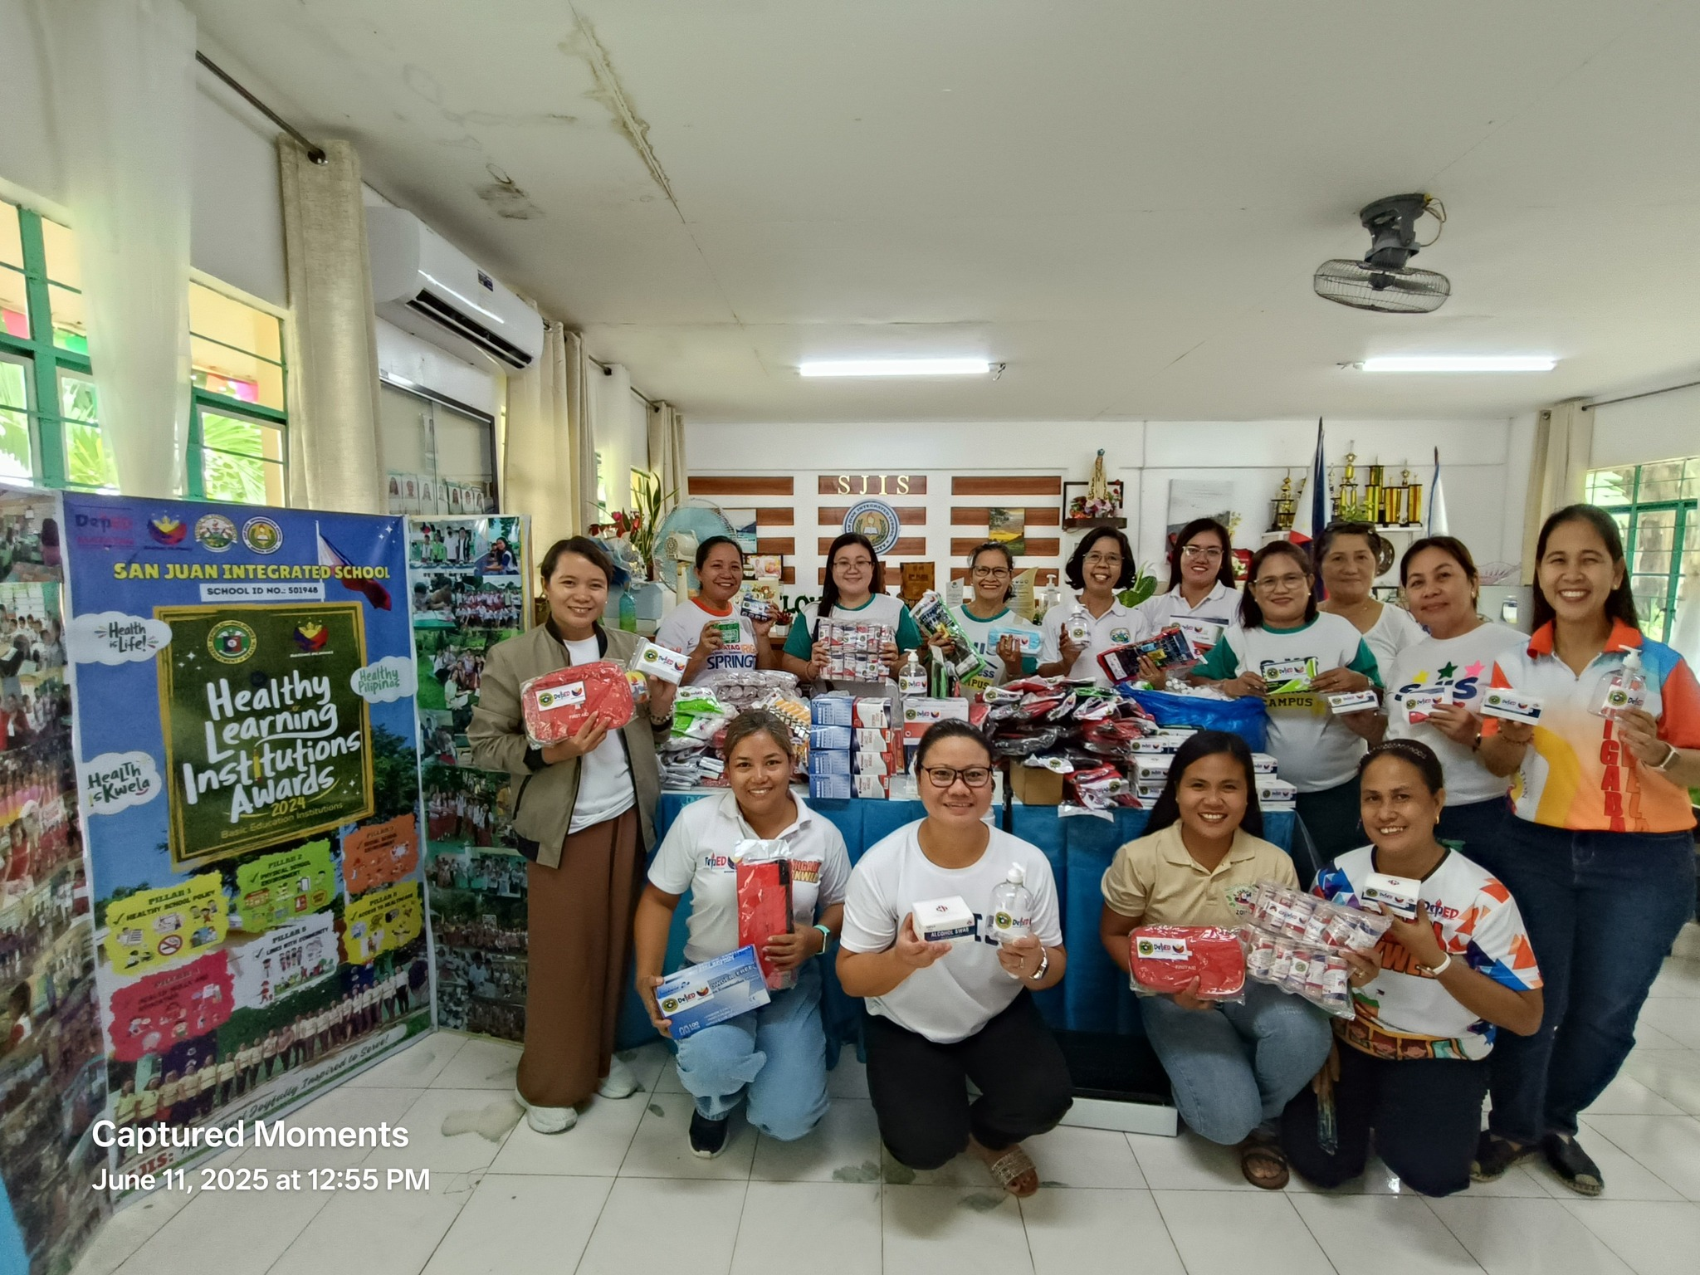
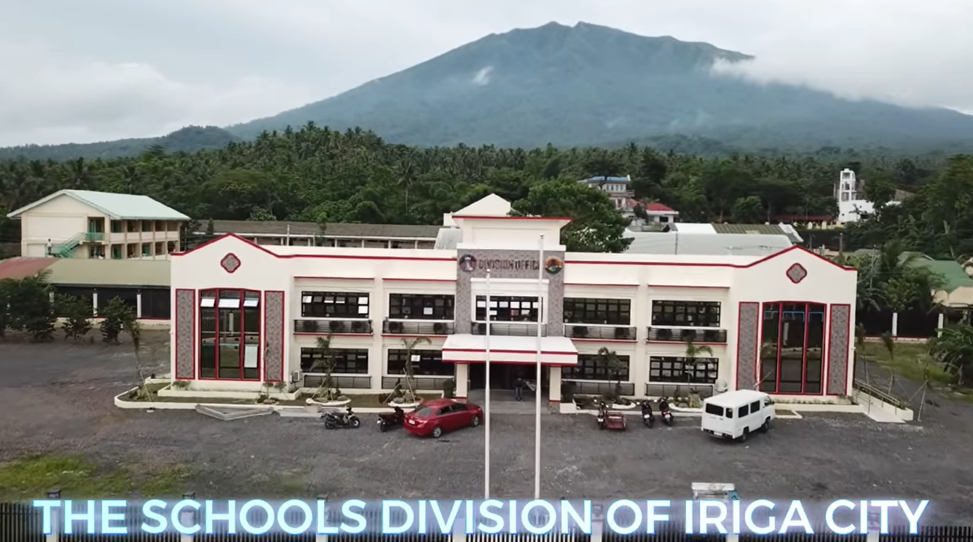
Quick wins
National Winner of
Healthy Pilipinas Award
BEST HEALTHY SCHOOL
San Juan Integrated School
Rinconada National Technical
Vocational School
BEST PRACTICES AWARD
San Juan Instegrated School
100% Completion CONSTRUCTION OF TWO STOREY SDO BUILDING AT IRIGA SOUTH CENTRAL SCHOOL COMPOUND, STO DOMINGO, IRIGA CITY.

Slide 89
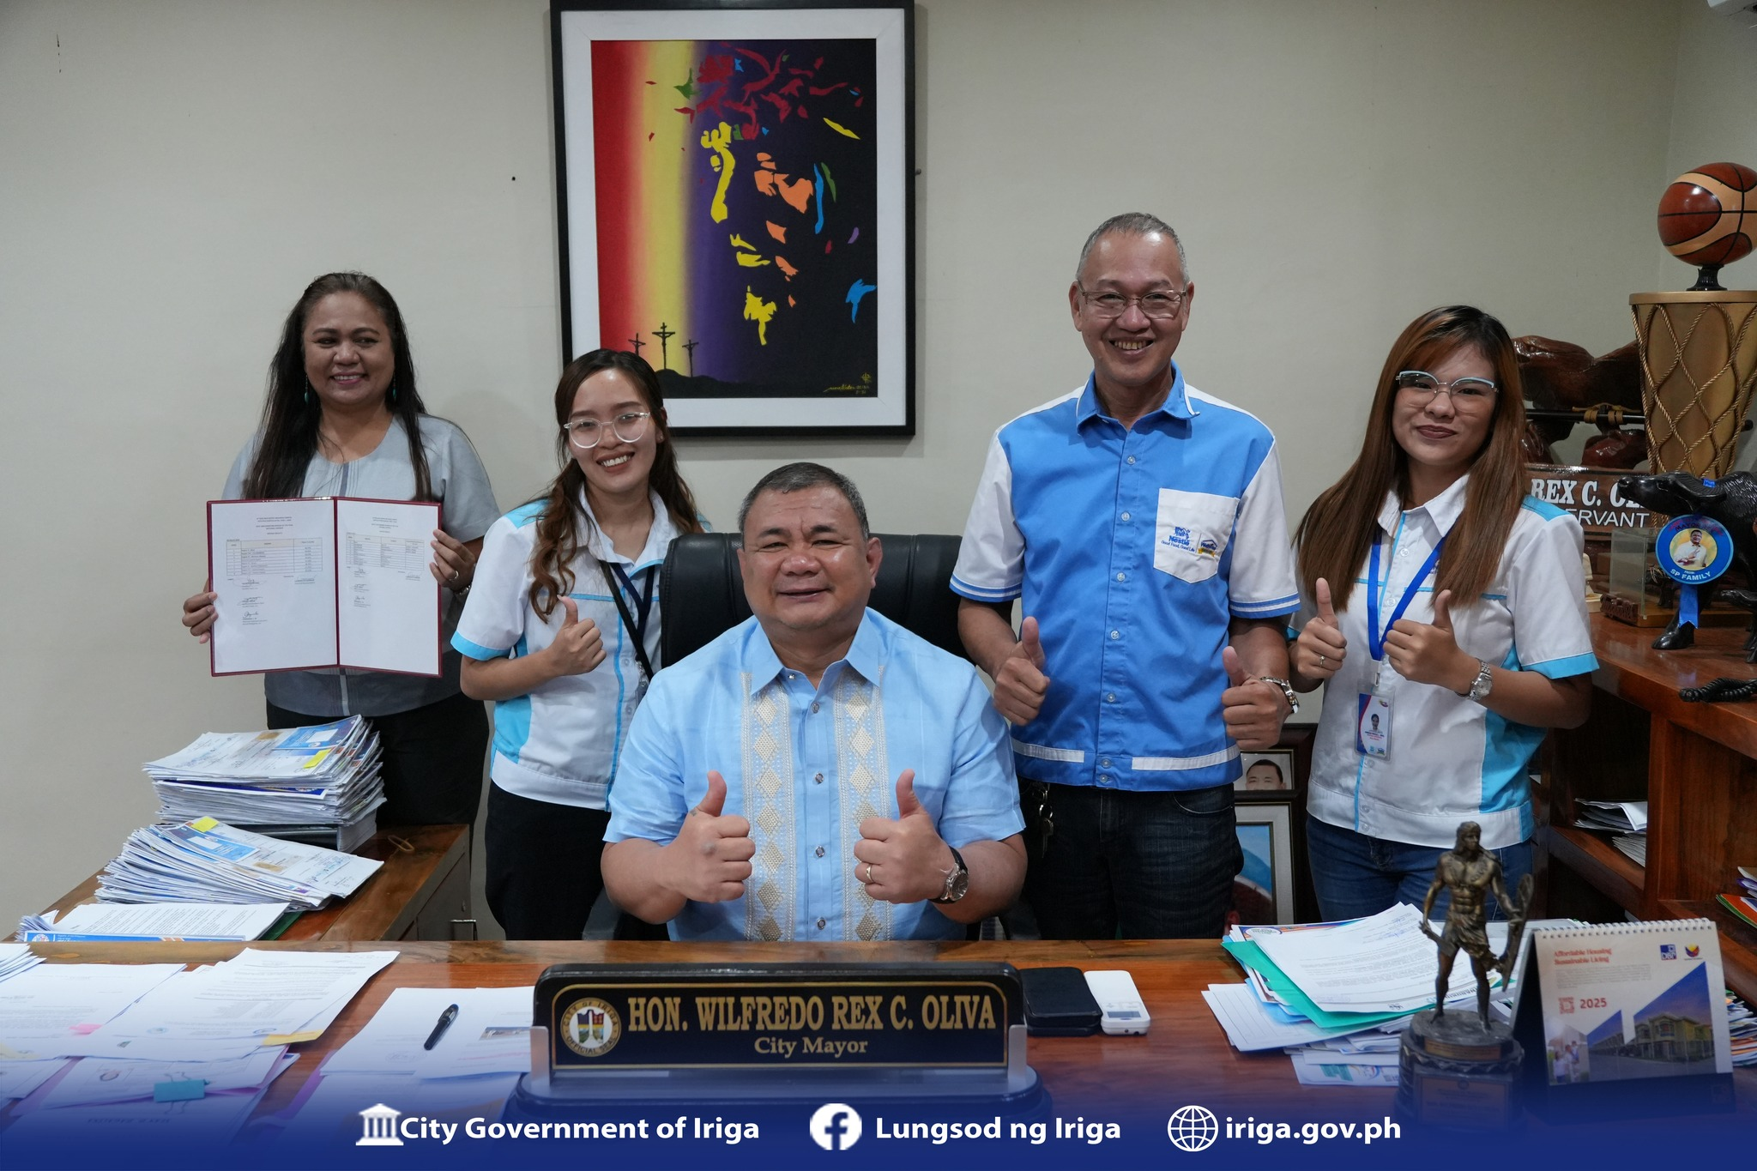
QUICK WINS
National Winners of the 2024-2025 Nestle Wellness Campus Competitions
Most Outstanding Division of the Year
Most Outstanding Focal Person of the Year
Best Implementing School
Hataw Sayaw Year 2
Research & development
- 8 Education Research by BERF
for CY 2025
- 12 Action Research were given Cash Assistance by Special Education Fund (SEF) CY 2024

Slide 90
INITIATIVE
Established partnership with the Higher Education Institution, UPNISMED, SEAMEO, PNU, CHED, and other TEIs for learning and development for teachers and school leaders
Providing technical assistance and conducted self-assessment on School-Based Management (SBM) both Elementary and Secondary Schools
100% Functionality School Governance Council (SGC) among secondary schools and 100% for Elementary Schools
Conduct of Regular Meeting and Monitoring for private schools 100 % compliance with regulatory requirement of private schools
Sustained partnership with Local Government Unit on grant for the 50,000.00 subsidy for the school physical improvement
CPD Accreditation of L & D Programs
Implementation of programs and initiatives anchored on evidence-based planning guided by IRIGA-PLUS-PROGRAM focusing on literacy and numeracy
Proyektong IRIGA Plus sa Sekondarya

Slide 91
Strengthened and sustained of education partners and stakeholders thru Brigada Eskwela and Brigada Pag-Basa/6Bs Program.
Operationalization of the Program Management Information System (PMIS).
Implementation to the School The 4:00 O’clock Sports Training Habit
Institutionalization of the functions of the Division Monitoring and Evaluation Team in M and E activities.
Use of Learning Management System (LMS) in monitoring and evaluating L and D activities.
INITIATIVE
Project LIBRO (Library Improvement for Better Reading Opportunities)
Project BRACE ME (Bridging Reading Apprehensions via Contextualization and Community Engagement for a Meaningful Educational Experience)
Crafted Monitoring Tool for the Opening of School Year 2025–2026

Slide 92
initiatives
INITIATIVEs
Training on “Enhancing Teaching Through Collaborative Lesson Study in Mathematics”
Division Training on Bridging Reading Across Languages
Division Training of Teachers on Language Strategies in Teaching Science, Math, & EPP/TLE in cooperation with Bicol University
Resilient Learning: Strategies for Education in Emergencies Through Alternative Delivery Mode
Project LIBRO (Library Improvement for Better Reading Opportunities)
Project BRACE ME (Bridging Reading Apprehensions via Contextualization and Community Engagement for a Meaningful Educational Experience)
Project GAINS (Gather Results on Learning Assessment and Initiative Intervention and Innovative Practices that Foster a Nurturing and Supportive Sustainable Environment)

Slide 93
initiatives
INITIATIVEs
Project COSINE: “Creating Optimum Synergic Interventions for Numeracy Enhancement”
Bridging the Digital Divide: Integrating GeoGebra and other digital tools to transition from traditional, static methods to dynamic, inquiry-based learning.
Empowering Educators: Utilizing Learning Action Cell (LAC) sessions to institutionalize the use of technology in lesson planning and peer mentoring.
Targeted Remediation: Providing "Optimum" interventions that specifically address the 25.96% of students requiring urgent numeracy support.

Slide 94
initiatives
INITIATIVEs
Project COSINE: “Creating Optimum Synergic Interventions for Numeracy Enhancement”
The Project COSINE was established as a proactive response to the critical findings in the Rapid Mathematics Assessment (RMA) for Key Stage 1, which revealed that approximately 65.88% of learners in the division are currently at the Emerging (Not Proficient and Low Proficient) levels. This data highlights a foundational gap where only 2.09% of students are performing At Grade Level.
The primary barrier identified is the limited exposure of learners to technology-based instruction, which restricts their ability to visualize and interact with abstract mathematical concepts. Project COSINE seeks to create a synergistic intervention

Slide 95
initiatives
INITIATIVEs
"IRIGA Plus: A Partner in Reading and Numeracy"
The IRIGA Plus Program is an intervention program in reading and numeracy by the Schools Division of Iriga City. It aims to provide support to learners who are struggling with reading and math. This program is designed to enhance the literacy and numeracy skills of students who need additional assistance, so they can keep up with their peers and achieve academic success.

Slide 96
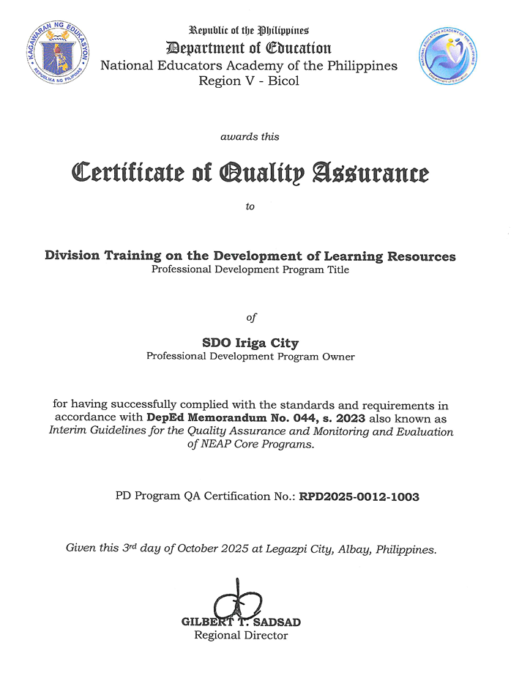
INITIATIVE
NEAP QUALITY ASSURED Professional development program:
division training ON THE DEVELOPMENT OF LEARNING RESOURCES WITH PD PROGRAM QA CERTIFICATION NO. RPD2025-0012-1003

Slide 97
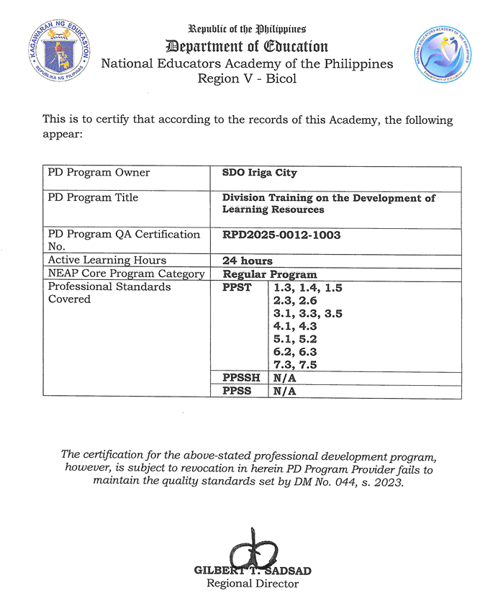
initiative
NEAP QUALITY ASSURED Professional development program:
division training ON THE DEVELOPMENT OF LEARNING RESOURCES WITH PD PROGRAM QA CERTIFICATION NO. RPD2025-0012-1003

Slide 98
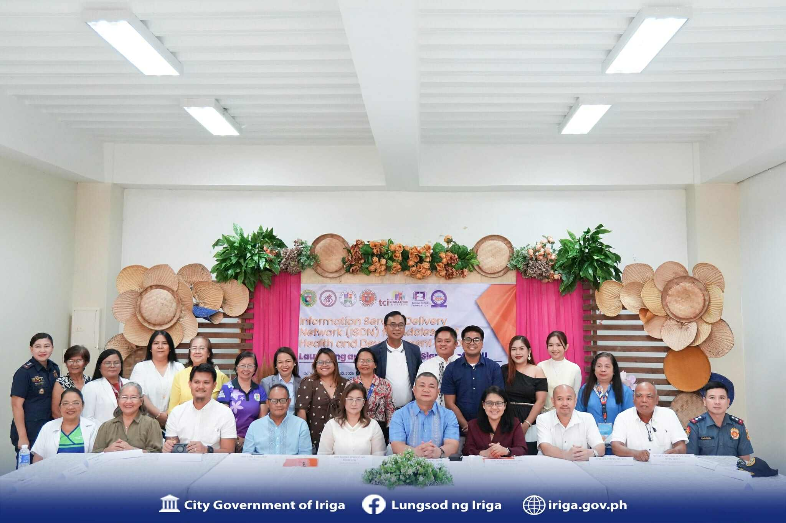
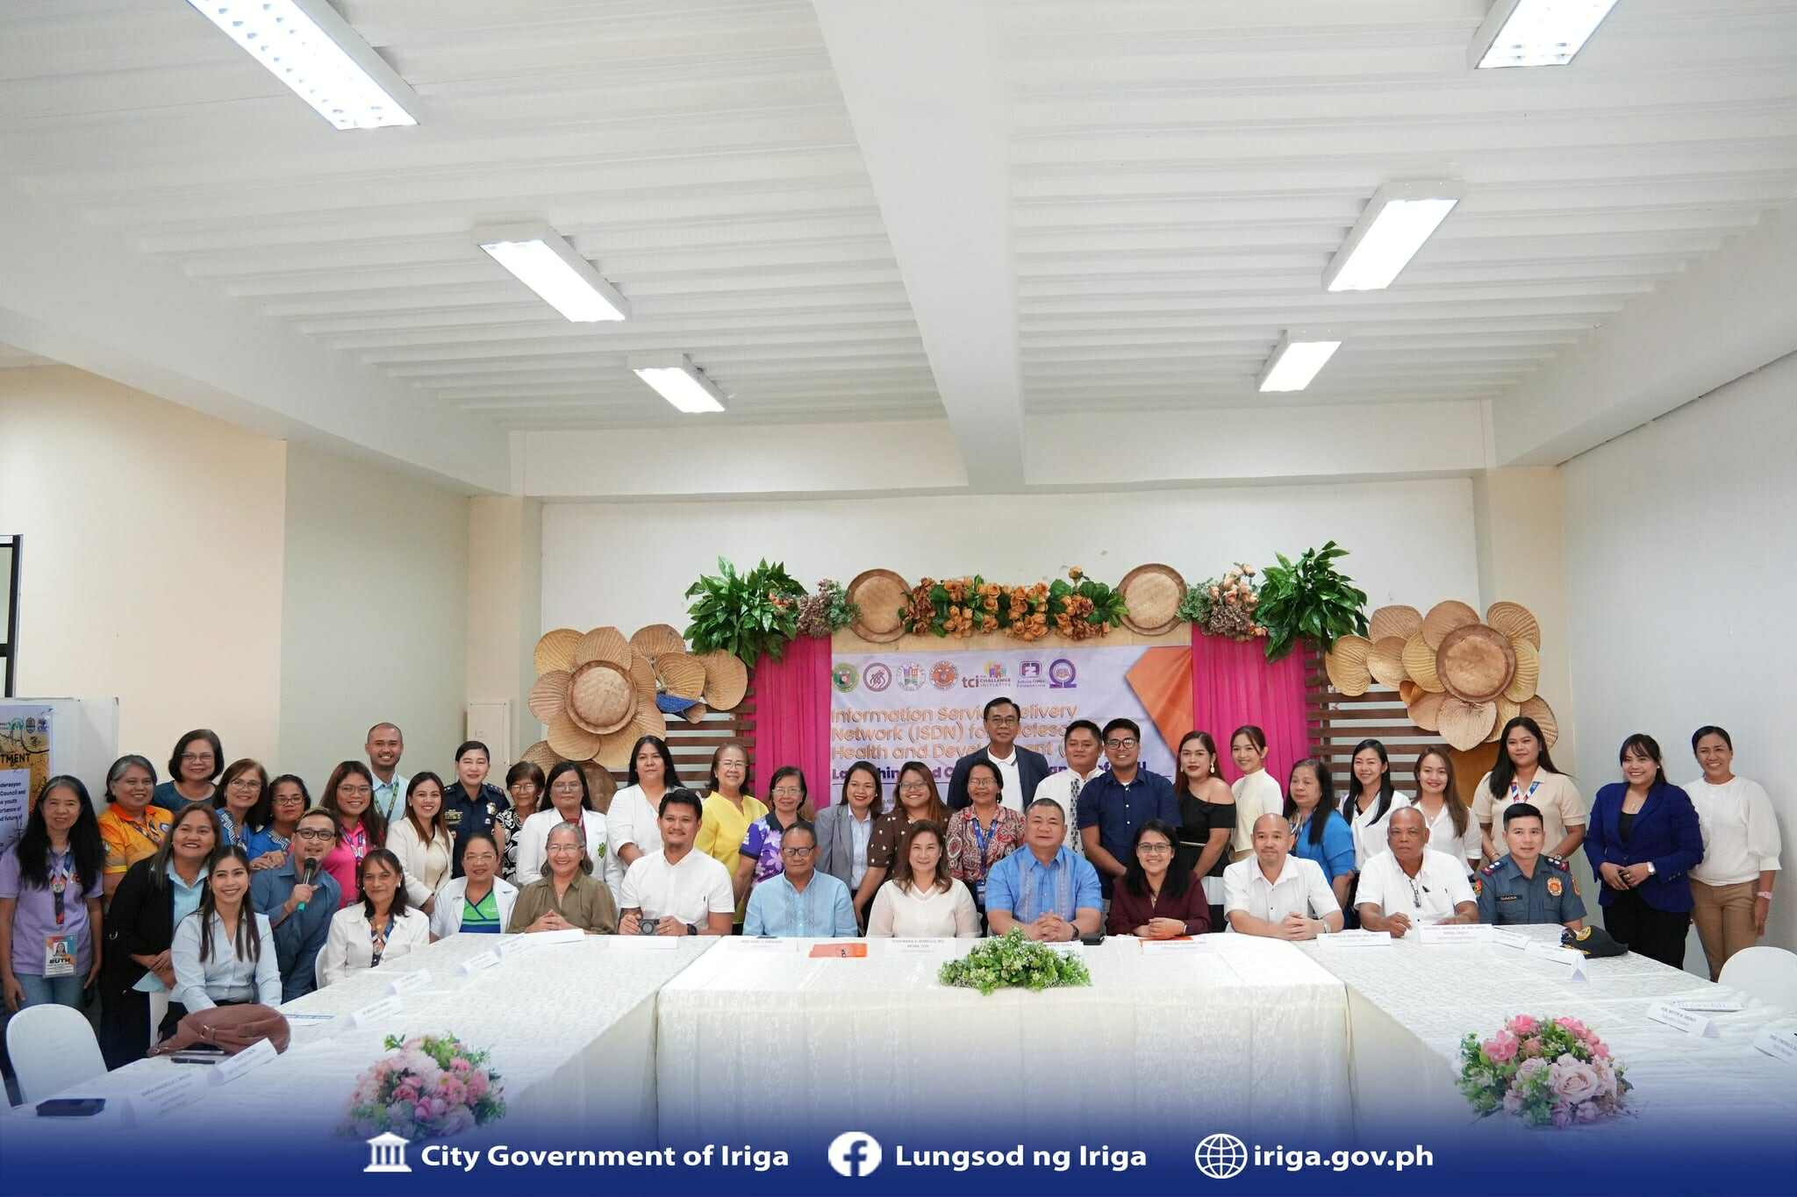
initiative
Partnership with LGU – CHO
Signing of the Memorandum of Understanding (MOU) of the Information Service Delivery Network (ISDN) for Adolescent Health and Development (AHD)

Slide 99
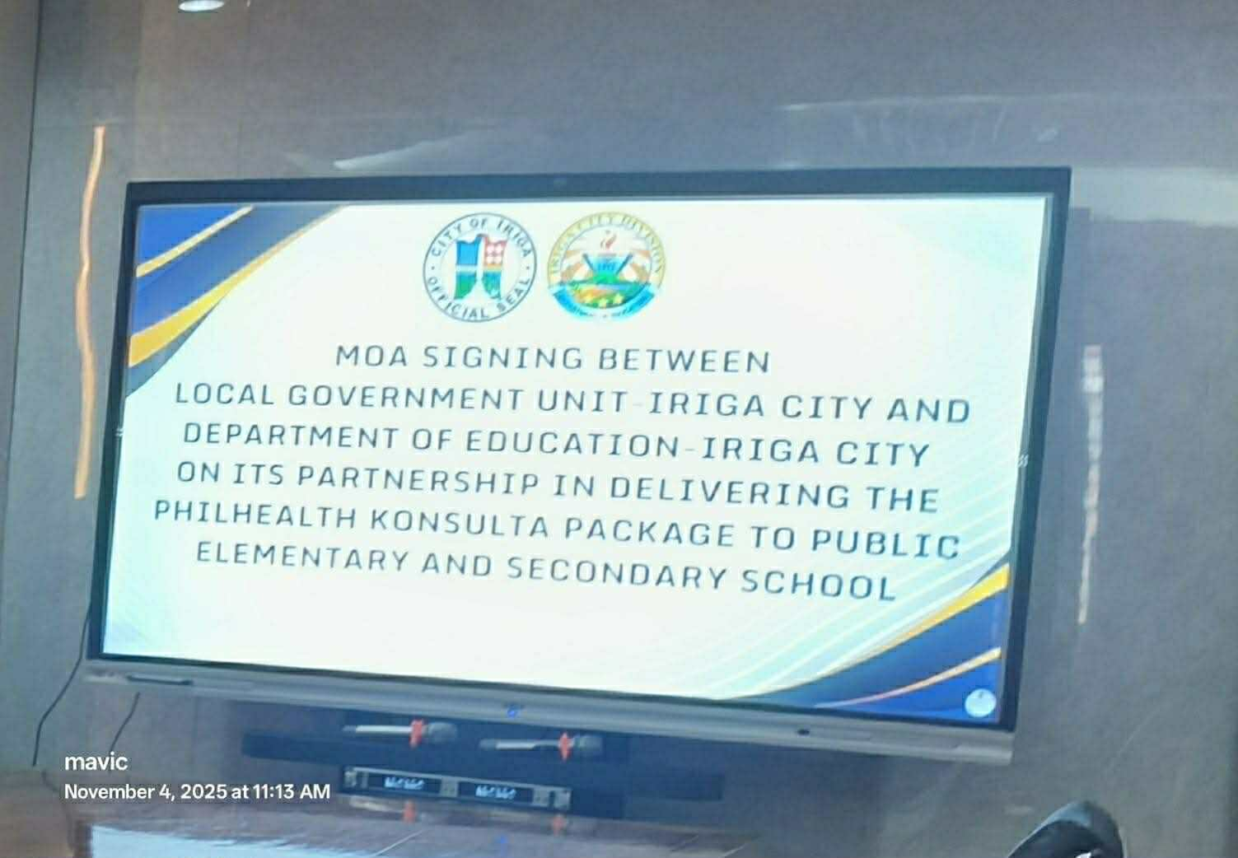
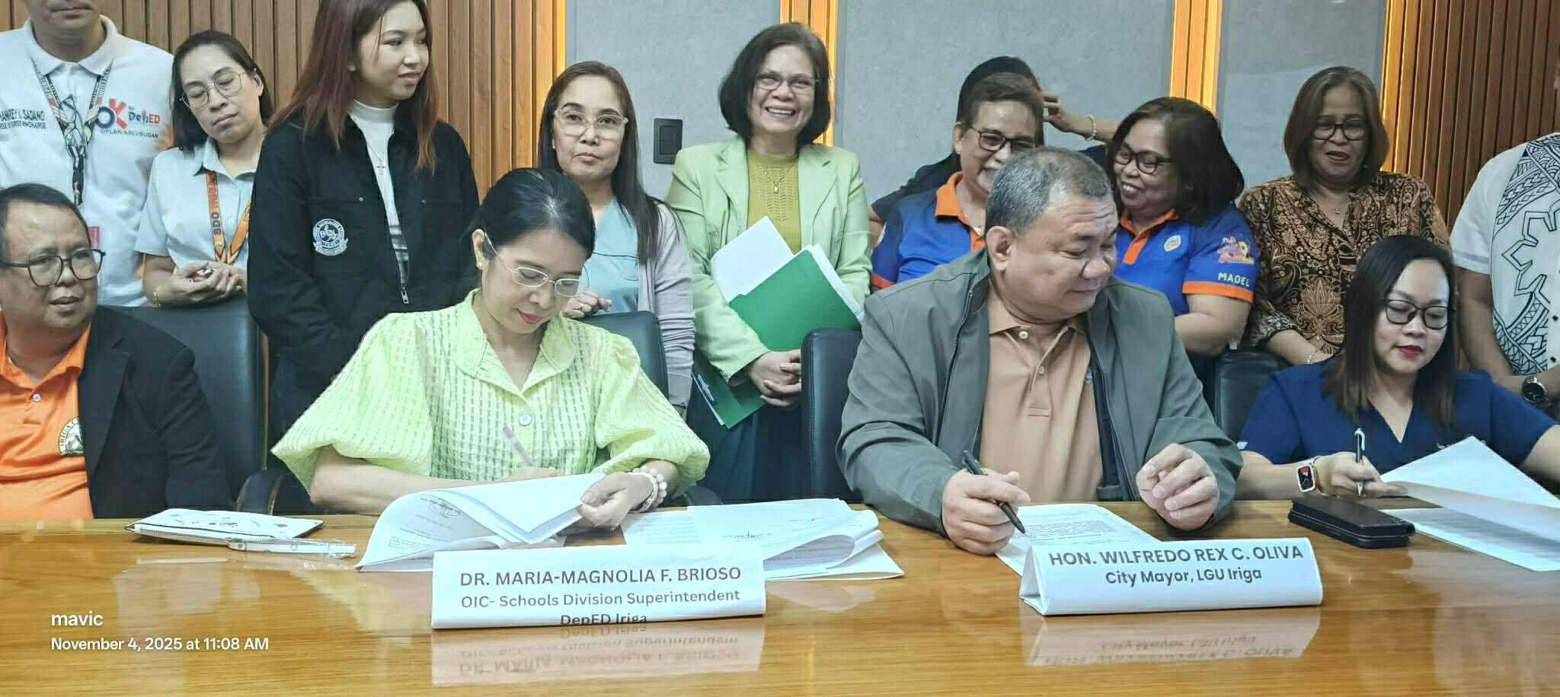
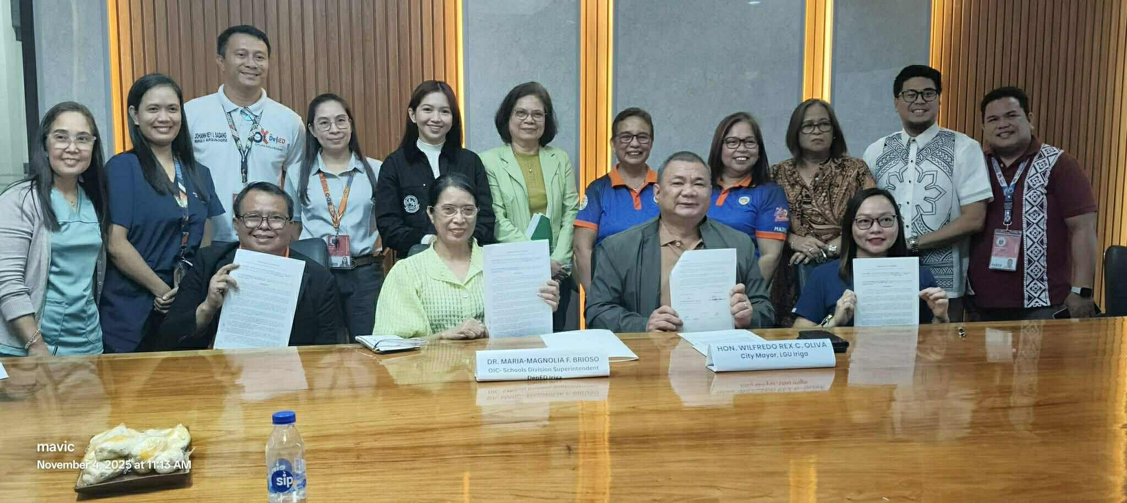
initiative
Partnership with LGU – CHO
Delivering Philhealth Konsulta-Package to Public Elementary and Secondary School

Slide 100
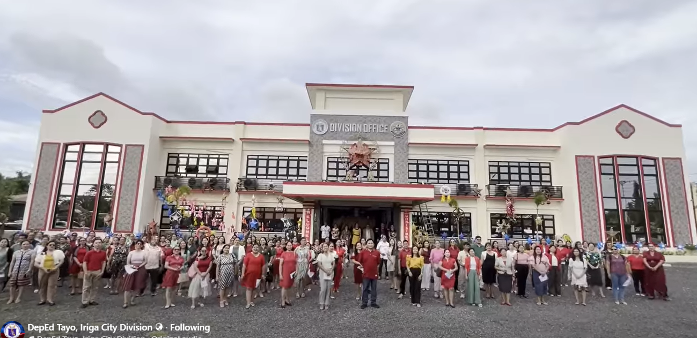
Quick wins
109 newly promoted Elementary teaching personnel under the Expanded Career Progression Program
Assessed Teacher Applicant for the Promotion of ECP

Slide 101
Quick wins
Regional Wellness Campus First Place Winner
Sto. Niňo National High School
2024 National Achievement Test for Grade 6
Ranked 2 Over all – Regional Level
Ranked 1 – Filipino (Regional Level)
Ranked 1 – Mathematics (Regional Level)
Ranked 2 – English, Science and AP
Philippine Mathematical Olympiad
Alyssa Louise C. Duro – Grade 11 USANT
First Place Winner in Luzon Cluster
National Finalist
Philippine Mathematical Olympiad
Alyssa Louise C. Duro – Grade 11 USANT
First Place Winner in Luzon Cluster
National Finalist
32nd Regional Eagle Quiz
Second Runner Up – Frances Nyah
Taduran – Grade 11 USANT

Slide 102
BEST PRACTICES
ASSESSMENT
In the 2024-2025 school year, there are a total of 2,145 Grade 3 learners in public elementary schools in SDO Iriga City. From these numbers, 1,975 have undergone reading validation under the IRIGA Plus Program, while 170 learners were absent.
This means that 92.07% of the whole Grade 3 population was assessed; thus, the data presented herein shows a general picture of the status of Grade 3 literacy in SDO Iriga City. The data also include 4 Schools with Zero-nonreaders. (San Andres ES, Nino Jesus ES, Santiago IS and Sta. Cruz Norte ES)
BEST PRACTICES

Slide 103
BEST PRACTICES
Comparative Analysis of 2024 – 2025 BoSY and EoSY RMA for Key Stage 1
 | Emerging (Not Proficient ) | Emerging (Low Proficient) | Developing (Nearly Proficient) | Transitioning (Proficient) | At Grade Level (Highly Proficient)
BoSY | 16.23% or 971 learners | 35.45% or 2122 learners | 31.03% or 1857 learners | 10.39% or 622 learners | 6.89% or 412 learners
EoSY | 4.04% or 242 | 11.04% or 661 learners | 27.69% or 1657 learners | 24.41% 1461 learners | 32.82% or 1964 learners
 | Decrease of 75.08% or 729 learners | Decrease of 221.03% or 1461 learners | Decrease of 10.77% or 200 learners | Increase of 134.89% or 839 learners | Increase of 376.70% or 1552 learners
Total Learners Assessed: 5985

Slide 104
Way forward
Continuous Modular/Blended Learning Delivery and Early identification and Basic Guidance support for ALS Learners
Intensify monitoring of 180 Days Non-Negotiable Contact Time for Teaching and Learning
Strengthen the literacy and numeracy program through our Reading, Science and Technology and Math Programs with the implementation of “PROJECT IRIGA PLUS (Intensifying Remedial Instruction for Greater Achievement)” by mobilizing stakeholders supports and initiatives.
Provide continuous support to inclusive education programs, including the Alternative Learning System (ALS), as well as initiatives for Indigenous Peoples (IP) learners and learners with disabilities.
Strengthen language-based teaching strategies across all learning areas to improve overall learning outcomes.
Intensify partnership among stakeholders and ensure the sustained implementation of the programs in all schools.
Conduct a research study to assess the alignment between validation results and reported Consolidated Reading and Literacy Assessment (CRLA) data, with the goal of revalidating and improving data accuracy.
Encourage schools with non-readers or a high number of learners requiring full reading intervention to benchmark best practices from schools with zero non-readers.

