Slide 1
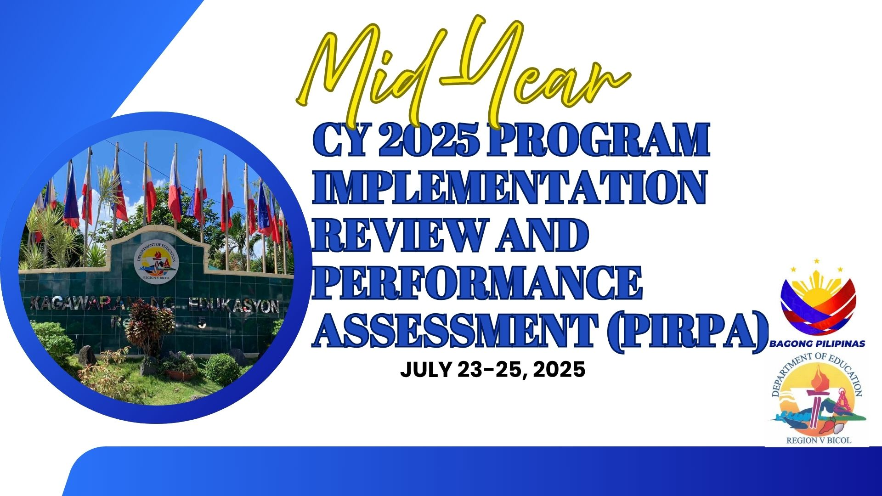


Slide 2

OFFICE: | Curriculum Implementation Division (CID)
HEAD: | JERSON V. TORALDE, EdD Chief ES - CID

Slide 3
INTERMEDIATE OUTCOMES PERFORMANCE INDICATORS
(per DepEd Oder No. 29, s. 2022 – Agency Performance Measurement Matrix)

Slide 4
Program, project and activities
(continuing 2024)

Slide 5
EQUITY
IO: Disadvantaged school-age children and youth, and adults benefited from appropriate equity initiatives

Slide 6
PPA/Line Item | Physical |  |  |  |  | Reasons for over/underperformance
 | Performance Indicator | Physical Target (Annual) | Accomplishment
 |  |  | Q1 | Q2 | %
SPED (Special Education Program-SNED) | No. of Schools Offering the program | 41 | 41 | 41 | 100% | N/A
 | No. of Enrolment | 397 | 397 | 397 | 100% | N/A
 | No. of Activities Conducted | 1 | 1 | N/A | 100% | Conducted February 2025
IPEd (Indigenous Peoples Education Program) | No. of Schools Offering the program | 40 | 40 | 40 | 100.00% | N/A
 | No. of Enrolment | 1626 | N/A |  | N/A | N/A
 | No. of Activities Conducted | 3 | 3 | N/A | 100% | Completed last January and February 2025
 | No. of Schools with program support funds (PSF) received | N/A | N/A | N/A | N/A | N/A

Slide 7
PPA/Line Item | Physical |  |  |  |  | Reasons for over/underperformance
 | Performance Indicator | Physical Target (Annual) | Accomplishment
 |  |  | Q1 | Q2 | %
MG (Multigrade Education Program) | No. of Schools Offering the program | 2 | 2 | 2 | 100%
 | No. of Enrolment | 123 | 123 | 123 | 100%
ALS (Alternative Learning System) | No. of Schools Offering the Program | 42 CLCs | 42 | 42 | 100.00%
 | No. of Enrolment | 975 | 748 | 748 | 76.72% | Presence of Nearby Integrated Schools
 | No. of Activities Conducted | 2 | 1 | 1 | 100>00%
 | No. of ALS teachers with paid transportation and teaching aid allowance | 20 | 20 | 20 | 100.00%
 | No. of CAIs teachers with paid transportation and teaching aid allowance | N/A | N/A | N/A | N/A | N/A
MEP (Madrasah Education Program) | No. of Schools Offering the Program | 1 | 1 | 1 | 100.00%
 | No. of Enrolment | 58 | 58 | 58 | 100.00%
 | No. of Asatidz paid | 2 | 2 | 2 | 100.00%
 | No. of Activities Conducted | 1 | N/A | N/A | N/A | Already conducted in 2024

Slide 8
Quality
IO: Learners complete K-12 basic education, having successfully attained all learning standards that equip them with the necessary skills and attributes to pursue their chosen paths

Slide 9
PPA/Line Item | Physical |  |  |  |  | Reasons for over/underperformance
 | Performance Indicator | Physical Target (Annual) | Accomplishment
 |  |  | Q1 | Q2 | %
Learning Tools Equipment (LTE) – Science and Mathematics (SM) | No. of tools and equipment delivered | 1 | 1 | N/A | 100.00%
 | No. of learners benefiting the program | 3 schools SJIS, SPNHS, ICSHS | 3 schools | N/A | 100.00%

Slide 10
PPA/Line Item | Physical |  |  |  |  | Reasons for over/underperformance
 | Performance Indicator | Physical Target (Annual) | Accomplishment
 |  |  | Q1 | Q2 | %
Learning Tools Equipment (LTE) – Tech-Voc and Livelihood(TVL) Equipment | No. of tools and equipment delivered | 74 | 0 | 71 | 95.95% | The fund was downloaded to ZAHS, and 3 items remain to be delivered
 | No. of learners benefiting the program | 19 | 19 | 19 | 100%
ELLN (Early Language Literacy and Numeracy) | No. of Activity Conducted | 1 | N/A | N/A | N/A | 100% conducted in 2024
 | No. of teachers trained | 105 | N/A | N/A | N/A | 100% ELLN Trained Teachers

Slide 11
PPA/Line Item | Physical |  |  |  |  | Reasons for over/underperformance
 | Performance Indicator | Physical Target (Annual) | Accomplishment
 |  |  | Q1 | Q2 | %
NASBE (National Assessment Systems for Basic Education ) | No. of National Assessments conducted | 3 | 1 | N/A | 33.33% | No ELLNA and NAT G12
 | No. of Activities conducted | 1 | 0 | 0 | 0.00% | To be implemented this Q3
FLO (Flexible Learning Options) | No. of Schools Provided with Learning Resources | 2 | 0 | 2 | 100.00% | Accomplished last 2024

Slide 12
PPA/Line Item | Physical |  |  |  |  | Reasons for over/underperformance
 | Performance Indicator | Physical Target (Annual) | Accomplishment
 |  |  | Q1 | Q2 | %
ADM (Alternative Delivery Mode) | No. of Activities Conducted | 1 | 0 | 0 | 0.00% | Obligated and to be conducted in Q3
ALSADM (Implementation of Alternative Learning and Delivery Mode Programs, including requirement of Learning Centers) | No. of Activities Conducted | N/A | N/A | N/A | N/A | N/A
 | No. of materials procured | N/A | N/A | N/A | N/A | N/A
 | No. of training/seminars/conferences attended | N/A | N/A | N/A | N/A | N/A
Journalism | No. of students participated in the National Press Conference | N/A | N/A | N/A | N/A | Fully accomplished in 2024
 | No. of Activities Conducted | N/A | N/A | N/A | N/A | Fully conducted in 2024

Slide 13
resiliencY and well-being
IO: Learners are resilient and know their rights and have the life skills to protect themselves and claim their education-related rights from DepEd and other duty-bearers to promote learners’ well-being.

Slide 14
PPA/Line Item | Physical |  |  |  |  | Reasons for over/underperformance
 | Performance Indicator | Physical Target (Annual) | Accomplishment
 |  |  | Q1 | Q2 | %
BEC (Basic Education Curriculum) | No. of learners participated in the activity (NLC) | 6240 | N/A | 100% | 100.00% | Learners actively participated the NLC
 | No. of Schools participated | 48 | N/A | 48 | 100.00% | All schools had participated the NLC
 | No. of teachers paid for their meal allowances | 374 | N/A | 374 | 100% | Teachers have been paid for their meal allowances
 | No. of capacity building/orientation conducted | 4 | N/A | 4 | 100% | 100% Capacity Building/Orientation have been conducted
 | No. of learning materials procured/produced | 18720 | N/A | 18720 | 100% | Learners were given LMs

Slide 15
PPA/Line Item | Physical |  |  |  |  | Reasons for over/underperformance
 | Performance Indicator | Physical Target (Annual) | Accomplishment
 |  |  | Q1 | Q2 | %
NASBE (National Assessment Systems for Basic Education ) | No. of National Assessments conducted | 3 | 1 | N/A | 33.33% | Only Grade 6 NAT was conducted
 | No. of Activities conducted | N/A | N/A | N/A | N/A | N/A

Slide 16
KEY PERFORMANCE INDICATORS AND Program, project and activities
(Current- 2025)

Slide 17
EQUITY
IO: Disadvantaged school-age children and youth, and adults benefited from appropriate equity initiatives

Slide 18
KPIs (Three-Year Data)
Performance Indicators | SY 2022-2023 | SY 2023-2024 | SY 2024-2025 | Reasons for Under/Over Performance
Elementary Gender Parity Index Completion | 1.00 | 1.01 | N/A | The trend reveals that there is parity between sexes (which means that more girls complete school compared to boys)
Secondary Gender Parity Index Completion | 1.02 | 1.10 | N/A | The trend reveals that there is parity between sexes (which means that more girls complete school compared to boys)

Slide 19
PPA/Line Item | Physical |  |  |  |  | Reasons for over/underperformance
 | Performance Indicator | Physical Target (Annual) | Accomplishment
 |  |  | Q1 | Q2 | %
SPED (Special Education Program-SNED) | No. of Schools Offering the program | 41 | 41 | 41 | 100%
 | No. of Enrolment | 397 | 397 | 397 | 100%
 | No. of Activities Conducted | 7 | 1 | 0 | 14.29% | On the process of submission of project proposal and waiting for Regional memorandum on the conduct of SNED activities.
IPEd (Indigenous Peoples Education Program) | No. of Schools Offering the program | 39 | 39 | 40 | 102. 56% | There is an additional school in Q2 which is SJIS
 | No. of Enrolment | 1626 | 1626 | 1631 | 100.31% | Additional school that offers the program
 | No. of Activities Conducted | 1 | 0 | 0 | 0.00% | Sub ARO has just been released and will be conducted in Q3
 | No. of Schools with program support funds (PSF) received | N/A | N/A | N/A | N/A | N/A

Slide 20
PPA/Line Item | Physical |  |  |  |  | Reasons for over/underperformance
 | Performance Indicator | Physical Target (Annual) | Accomplishment
 |  |  | Q1 | Q2 | %
MG (Multigrade Education Program) | No. of Schools Offering the program | 2 | 2 | 2 | 100.00%
 | No. of Enrolment | 123 | 123 | 118 | 95.93% | There is a lower number of enrollees in the KS2 by 4.07%
ALS (Alternative Learning System) | No. of Schools Offering the Program | 44 | 44 | 44 | 100.00%
 | No. of Enrolment | 1500 | 748 | 748 | 49.80% | 50% of the mapped potential learners did not enroll in the ALS programs. Most of the school-aged children and youth as well as some OSY were enrolled in the formal school.
 | No. of Activities Conducted | 20 | 5 | 3 | 42.10% | Other activities will be conducted in Q3
 | No. of ALS teachers with paid transportation and teaching aid allowance | 20 | 20 | 20 | 100.00%
 | No. of CAIs teachers with paid transportation and teaching aid allowance | N/A | N/A | N/A | N/A | N/A
MEP (Madrasah Education Program) | No. of Schools Offering the Program | 1 | 1 | 1 | 100.00%
 | No. of Enrolment | 38 | 38 | 39 | 102.40%
 | No. of Asatidz paid | 2 | 2 | 2 | 100.00%
 | No. of Activities Conducted | 5 | 1 | 2 | 40.00% | Other activities shall be conducted in Q3

Slide 21
Quality
IO: Learners complete K-12 basic education, having successfully attained all learning standards that equip them with the necessary skills and attributes to pursue their chosen paths

Slide 22
KPIs (Three-Year Data)
Elementary | SY 2022-2023 | SY 2023-2024 | SY 2024-2025
Elementary Completion Rate | 99.64% | No data available yet | No data available yet
Percentage of learners achieving nearly proficient or better in English | 42. 10 MPS (NATG10) and 43.33 MPS (NATG12) | NDA | NDA
Percentage of learners achieving nearly proficient or better in Numeracy | KS3: 7.203% (EOSY ALNAT 2022 – 2023) | KS3: 3.987% (EOSY ALNAT 2023 – 2024) | KS3: 18.56% (EOSY ALNAT 2024 – 2025)
Percentage of Grade 6 learners attaining nearly proficient level or better in stage 2 literacy standards | NDA | 38.78% (Phil-IRI) | 40.04% (Phil-IRI)
Percentage of Grade 6 learners attaining nearly proficient level or better in stage 2 numeracy standards | KS2: 13.252% (EOSY ALNAT 2022 – 2023) | KS2: 14.575% (EOSY ALNAT 2023 – 2024) | KS2: 21.388% (EOSY ALNAT 2024 – 2025)

Slide 23
KPIs (Three-Year Data)
Secondary | SY 2022-2023 | SY 2023-2024 | SY 2024-2025
Secondary Completion Rate | 94. 63 | There is currently no data available | There is currently no data available
Percentage of Grade 10 learners attaining nearly proficient level or better in stage 3 literacy standards | 40.00 MPS (NATG10) | 38.09% | 50.45%
Percentage of Grade 10 learners attaining nearly proficient level or better in stage 3 numeracy standards | 33.42 MPS (NATG10) | KS3: 3.987% (EOSY ALNAT 2023 – 2024) | KS3: 18.56% (EOSY ALNAT 2024 – 2025)
Percentage of Grade 12 learners attaining nearly proficient level or better in stage 4 SHS areas | 39.96 MPS (NATG12) | Conducted but no results | Conducted but no results yet

Slide 24
PPA/Line Item | Physical |  |  |  |  | Reasons for over/underperformance
 | Performance Indicator | Physical Target (Annual) | Accomplishment
 |  |  | Q1 | Q2 | %
Learning Tools Equipment (LTE) – Science and Mathematics (SM) | No. of tools and equipment delivered | 1 | 0 | 0 | 0.00% | The documents had been submitted to the BAC for the procurement process, and the BID had been evaluated
 | No. of learners benefiting the program | 12 Elementary schools | 0 | 0 | 0.00% | To be distributed in Q4

Slide 25
PPA/Line Item | Physical |  |  |  |  | Reasons for over/underperformance
 | Performance Indicator | Physical Target (Annual) | Accomplishment
 |  |  | Q1 | Q2 | %
Learning Tools Equipment (LTE) – Tech-Voc and Livelihood(TVL) Equipment | No. of tools and equipment delivered | N/A | N/A | N/A | N/A | No available fund downloaded
 | No. of learners benefiting the program | N/A | N/A | N/A | N/A | N/A
ELLN (Early Language Literacy and Numeracy) | No. of Activity Conducted | 1 | 0 | 0 | 0.00% | To be conducted in Q3
 | No. of teachers trained | T-30 SHs - 10 | 0 | 0 | 0.00% | To be trained in Q3

Slide 26
PPA/Line Item | Physical |  |  |  |  | Reasons for over/underperformance
 | Performance Indicator | Physical Target (Annual) | Accomplishment
 |  |  | Q1 | Q2 | %
Textbooks (and Other Instructional materials) | No. of schools provided with textbooks/instructional materials | 55 | 0 | 55 | 100%
NASBE (National Assessment Systems for Basic Education ) | No. of National Assessments conducted | 3 | 1 | 0 | 33.33% | NAT G12 and ELLNA to be conducted as per DM
 | No. of Activities conducted | 1 | 0 | 0 | 0.00% | To be conducted in Q3
FLO (Flexible Learning Options) | No. of Schools Provided with Learning Resources | 2 | 0 | 0 | 0.00% | Waiting for the 2025 Sub Aro

Slide 27
PPA/Line Item | Physical |  |  |  |  | Reasons for over/underperformance
 | Performance Indicator | Physical Target (Annual) | Accomplishment
 |  |  | Q1 | Q2 | %
ADM (Alternative Delivery Mode) | No. of Activities Conducted | 1 | 0 | 0 | 0.00% | On the process of preparing the procurement documents for BAC Action
ALSADM (Implementation of Alternative Learning and Delivery Mode Programs, including requirement of Learning Centers) | No. of Activities Conducted | 5 | 0 | 0 | 0.00% | Activities are scheduled on the second and fourth quarters
 | No. of materials procured | 60 | 0 | 0 | 0.00% | Still under procurement process (Procurement of supplies and materials in support to teaching and learning of ALS teachers and learners – Ink for Printers and Sign Pens)
 | No. of training/seminars/conferences attended | 17 | 2 |  | 11.76 | Only 1 division training-workshop for teachers and 1 BAE sponsored conference were attended by the teachers, EPSA, and Division Focal Person and select personnel for Quarter 1.
Journalism | No. of students participated in the National Press Conference | 100 | 0 | 0 | 0.00% | To be participated in Q4
 | No. of Activities Conducted | 1 | 0 | 0 | 0.00% | To be conducted in Q3

Slide 28
resiliencY and well-being
IO: Learners are resilient and know their rights and have the life skills to protect themselves and claim their education-related rights from DepEd and other duty-bearers to promote learners’ well-being.

Slide 29
PPA/Line Item | Physical |  |  |  |  | Reasons for over/underperformance
 | Performance Indicator | Physical Target (Annual) | Accomplishment
 |  |  | Q1 | Q2 | %
BEC (Basic Education Curriculum) | No. of learners participated in the activity (SARP and LRP | SARP – 45 LRP - 128 | N/A | 45 and 128 | 100.00%
 | No. of Schools participated | SARP -5 LRP - 23 | N/A | SARP – 5 LRP - 23 | 100.00%
 | No. of teachers paid for their meal allowances | SARP 19 LRP - 24 | N/A | 0 | 0.00% | The documents are still being processed
 | No. of capacity building/orientation conducted | N/A | N/A | N/A | N/A | N/A
 | No. of learning materials procured/produced | N/A | N/A | N/A | N/A | N/A

Slide 30
PPA/Line Item | Physical |  |  |  |  | Reasons for over/underperformance
 | Performance Indicator | Physical Target (Annual) | Accomplishment
 |  |  | Q1 | Q2 | %
NASBE (National Assessment Systems for Basic Education ) | No. of National Assessments conducted | 3 | 1 | 0 | 33.33% | NAT G12 and ELLNA to be conducted as per DM
 | No. of Activities conducted | 1 | 0 | 0 | 0.00% | To be conducted in Q3

Slide 31
Enabling Environment Performance Indicators

Slide 32

EQUITY
BCCs in Achieving the KPI Targets
Overlapping activities and other funds were just downloaded for this quarter

Slide 33
BCCs in Achieving the KPI Targets
QUALITY
Sense of urgency with regard to the submission of all the required documents to the concerned office.
Limited Exposure of learners to technology based – instruction.
Need to intensify professional training/ development/seminar for teachers in beginning reading and numeracy instruction
Insufficient training to teachers in numeracy engagement
Low results in the ALNAT for 2022.2023 to 2024 - 2025
With regards to the literacy and numeracy which is to attain the 75% nearly proficient, training activities to teachers should be given and continuous technical assistance should take place.
Limited Exposure of learners to technology based – instruction.

Slide 34
BCCs in Achieving the KPI Targets
RESILIENCE
WELL-BEING
The fund has just been downloaded recently.
Unwillingness of parents/guardians for their children to be included in the summer program
Advocacy program for stakeholders.

Slide 35
INITIATIVES
1. IRIGA Plus Program
2. Project LIBRO (Library Improvement for Better Reading Opportunities)
3. Project COSINE (Creating Optimum Synergic Innovations for Numeracy Enhancement)
4. Project BRACE ME (Bridging Reading Apprehensions via Contextualization and Community Engagement for a Meaningful Educational Experience)
5. Project GAINS (Gather Results on Learning Assessment and Initiative Intervention and Innovative Practices that Foster a Nurturing and Supportive Sustainable Environment)

Slide 36


QUICK WINS
2025 Philippine International Mathematical Olympiad (PhIMO) Heat Round Held last April 6, 2025
Name | Grade Level | Award | School | Coach
Johne Xhander Alfelor | Grade 12 | Silver | ZAHS | Erma O. Bagacina
Michael Vinz Cedo | Grade 9 | Bronze | ZAHS | Michael C. Villareal
Eduard Vince Naron | Grade 8 | Merit | ZAHS | Michael C. Villareal
Principal: Dr. Ludevina Ester D. Bolante, P-IV
They will participate in the 2025 Philippine Math Olympiad (PhIMO) Final Round on September 19 – 22, 2025 at Jpark Island – Resort and Waterpark, Cebu, Philippines

Slide 38






Contigent: Iriga City
National Schools Press Conference (NSPC) 2025 Results
@ Vigan City, Ilocos Sur (May 19 - 23, 2025)

Slide 39


Elementary
1st Place
Collaborative and Desktop Publishing - Filipino
Iriga Central School

Slide 40




Xhendrea Elyz E. Pandes
Raphael Euan C. Regalado
Yushie M. Yorobe
Zamantha Nichole D. Vargas
Andressa Mae A. Escano

Slide 41
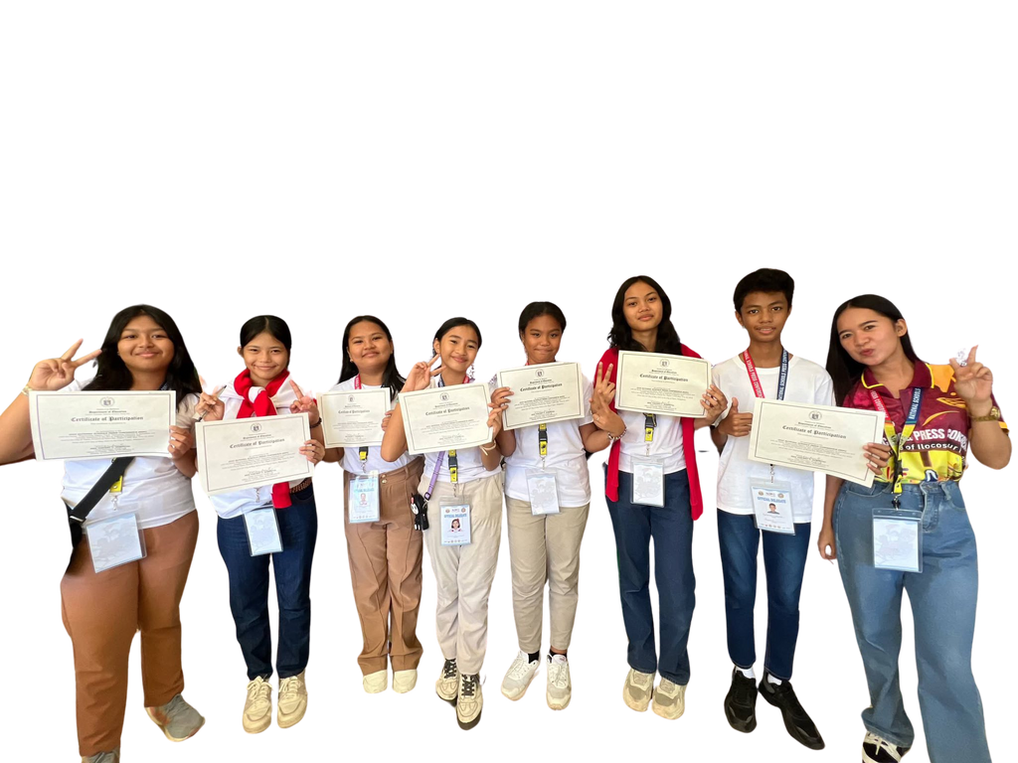

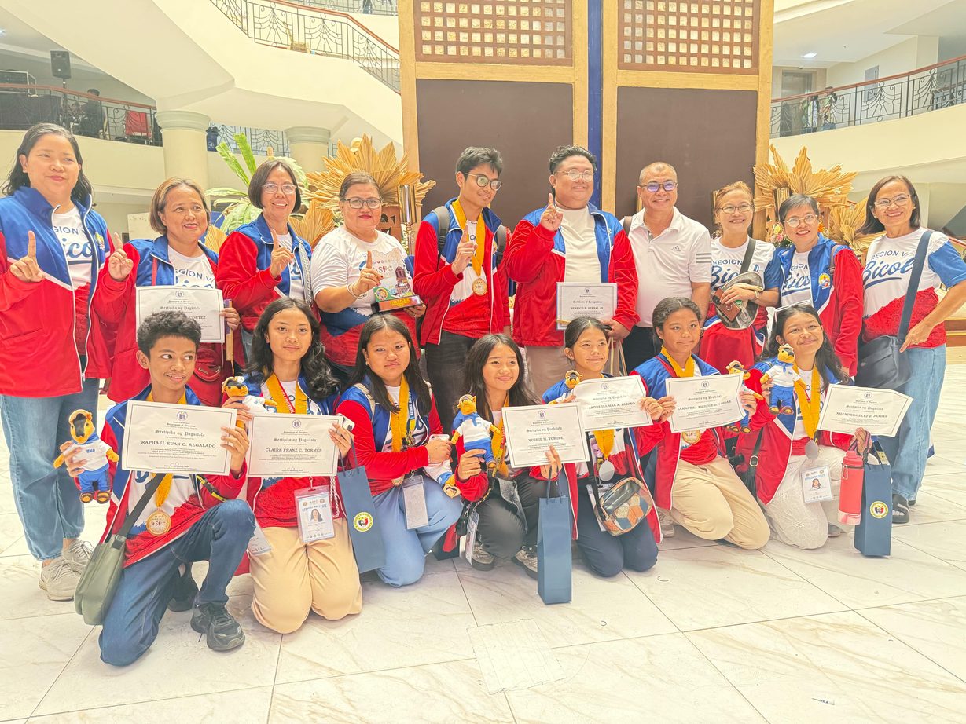
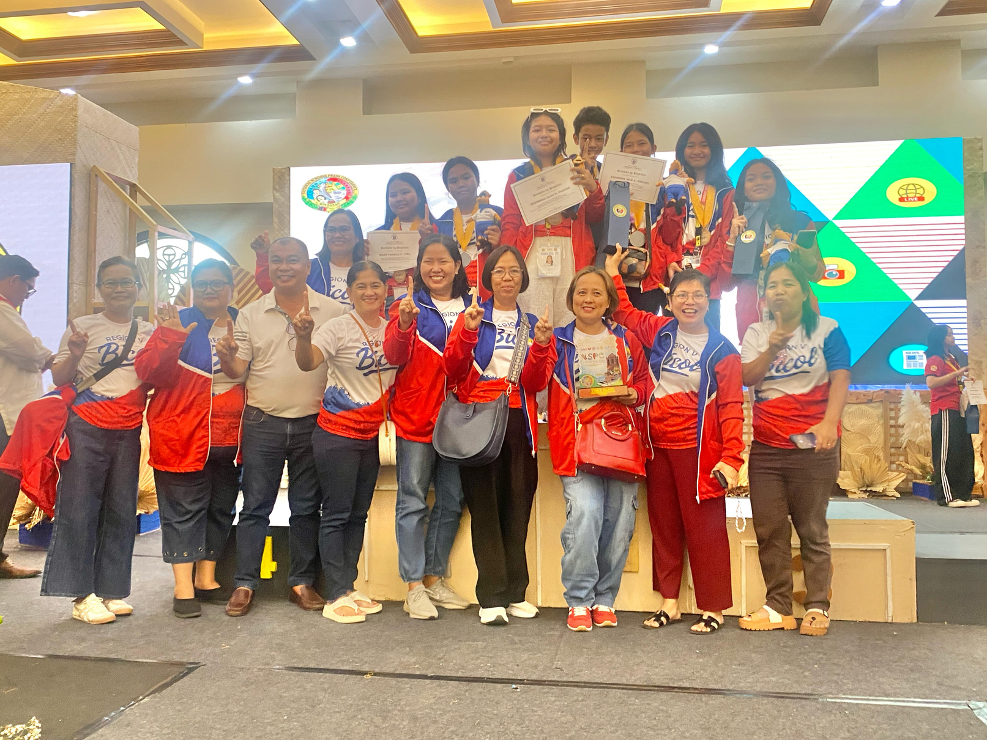

Slide 42
Secondary
1st Place
Column Writing - English
University of Saint Anthony

Slide 43
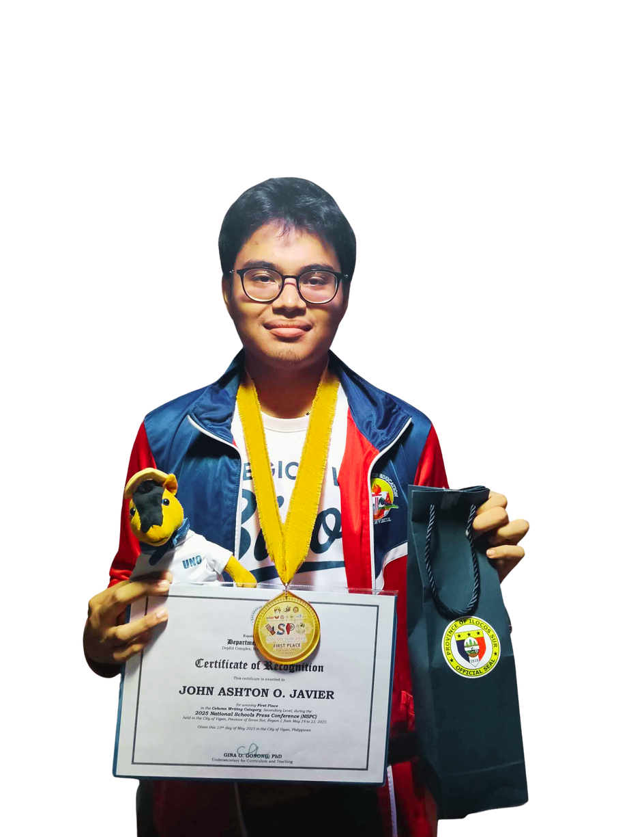
John Ashton O. Javier

Slide 44
Mariano B. de Guzman, CESO V
Schools Division Superintendent
Maylani L. Galicia
Assistant Schools Division Superintendent
Jerson V. Toralde
Chief, Curriculum Implementation Division
Rechie O. Salcedo
EPS - 1 Filipino
Claudia Marilou S. Marpuri
EPS - 1 English
Leopoldo R. Dato, Jr.
ICS Principal II/OIC PSDS
Ma. Theresa I. Cortez
Juvy G. Clavillas
Baby Elsie M. Jove
Cindy A. Filio
Dolores R. Andalis
Coaches (Elementary)
Nenita T. Andalis
USANT Principal
Henrico B. Sernal Jr.
Coach (Secondary)

Slide 45
BEST PRACTICES
"IRIGA Plus: A Partner in Reading and Numeracy"
The IRIGA Plus Program is an intervention program in reading and numeracy by the Schools Division of Iriga City. It aims to provide support to learners who are struggling with reading and math. This program is designed to enhance the literacy and numeracy skills of students who need additional assistance, so they can keep up with their peers and achieve academic success.

Slide 46
Objectives:
Improve the reading and numeracy skills of learners who need support
Strengthen students’ confidence and motivation in learning
Provide additional support and resources for teachers to address learning gaps
Promote a culture of reading and numeracy in schools and communities
Program Components:
Reading Intervention: Targeted instruction and reading activities to develop learners’ reading abilities
Numeracy Support: Math activities and exercises to improve learners’ numeracy skills
Teacher Training: Professional development for teachers to strengthen their teaching strategies
Community Engagement: Partnerships with parents, community leaders, and other stakeholders to promote reading and numeracy

Slide 47
Expected Outcomes:
Eliminate or significantly reduce the number of non-readers
Improved reading and numeracy skills of struggling learners
Increased confidence, motivation, and capacity of teachers in teaching reading and math
Strong collaboration with the LGU to provide proper support for quality education

Slide 48

SUMMARY OF LEARNERS
In the 2024-2025 school year, there are a total of 2,145 Grade 3 learners in public elementary schools in SDO Iriga City. From these numbers, 1,975 have undergone reading validation under the IRIGA Plus Program, while 170 learners were absent.
This means that 92.07% of the whole Grade 3 population was assessed; thus, the data presented herein shows a general picture of the status of Grade 3 literacy in SDO Iriga City.

Slide 49
DISTRIBUTION OF LEARNERS BY DISTRICT
As expected, Central District has the highest number of enrolment and learners assessed. However, as regards the learner assessed, North District registered the highest percentage of learners assessed with 95.57% followed by South District with 93.00%, and Central District registered the lowest percentage of learners assessed with 89.53%

Slide 50
SDO’s Literacy Performance in Grade 3
Overall, Grade 3 learners in SDO Iriga City are in the Light intervention level with 31.42%. This was followed by the meeting expectations with 29.78%, then by Moderate Intervention (23.86%). However, there are 13.58% who are still at full intervention level

Slide 51
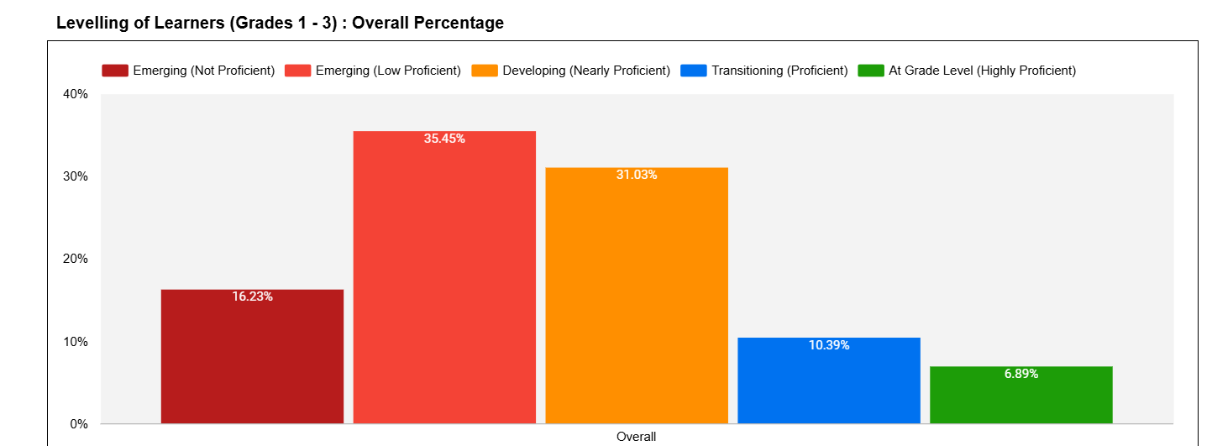
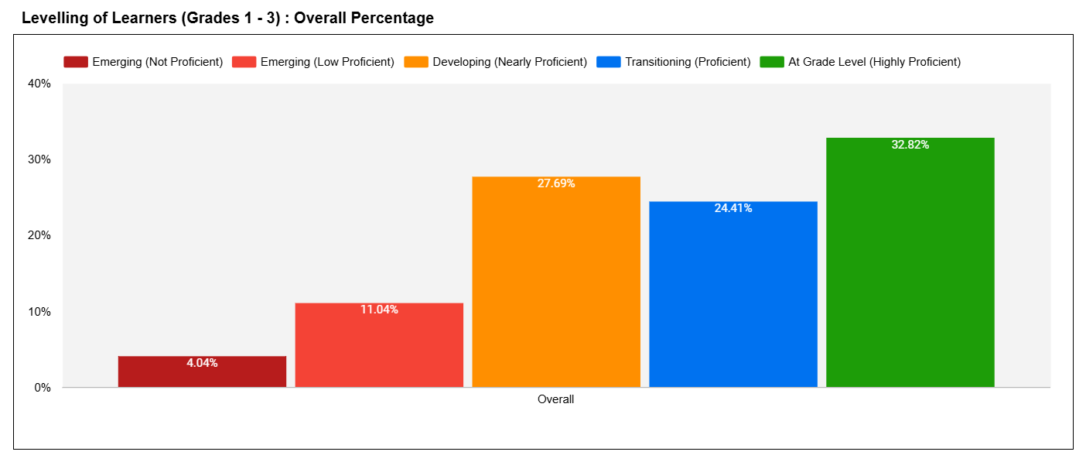
Results 2024 – 2025 BoSY and EoSY RMA for Key Stage 1

Slide 52
Comparative Analysis of 2024 – 2025 BoSY and EoSY RMA for Key Stage 1
 | Emerging (Not Proficient ) | Emerging (Low Proficient) | Developing (Nearly Proficient) | Transitioning (Proficient) | At Grade Level (Highly Proficient)
BoSY | 16.23% or 971 learners | 35.45% or 2122 learners | 31.03% or 1857 learners | 10.39% or 622 learners | 6.89% or 412 learners
EoSY | 4.04% or 242 | 11.04% or 661 learners | 27.69% or 1657 learners | 24.41% 1461 learners | 32.82% or 1964 learners
 | Decrease of 75.08% or 729 learners | Decrease of 221.03% or 1461 learners | Decrease of 10.77% or 200 learners | Increase of 134.89% or 839 learners | Increase of 376.70% or 1552 learners
Total Learners Assessed: 5985

Slide 53
WAYS FORWARD
Sustain the implementation of the program in all schools.
Conduct a research study on the alignment of the results of the validation against the reported CRLA results to revalidate the data.
Allow schools with non-readers and higher numbers of full intervention to benchmark best practices from schools with zero non-readers.

Slide 54
Thank you!

